Slide 1
Perspectives on COVID-19 October 13, 2021
Dennis Cunningham MD, MHA, FAAP
System Medical Director, Infection Prevention

Slide 2
Objectives
Share current COVID-19 epidemiology in Michigan
Briefly describe treatment options for COVID infection with emphasis on outpatient monoclonal antibodies
Discuss immune protection from natural infection versus vaccines
Summarize vaccine next steps
Consider the impact of future COVID variants

Slide 3
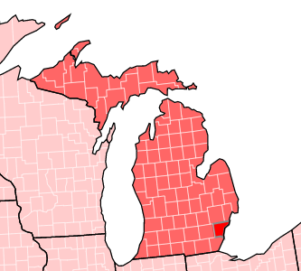
Michigan COVID Data as of 10/12/2021
All counties in red: “high” transmission of COVID-19
At least 100 cases / 100,000 people in each county
https://covid.cdc.gov/covid-data-tracker/#county-view|Michigan|26003|Risk|community_transmission_level
Michigan has total of 1,198,850 cases
1,064,557 confirmed cases
134,293 probable cases
Clinical diagnosis and known link to confirmed case
22,738 deaths (case fatality rate just under 2%)
https://www.michigan.gov/coronavirus/0,9753,7-406-98163_98173---,00.html

Slide 4
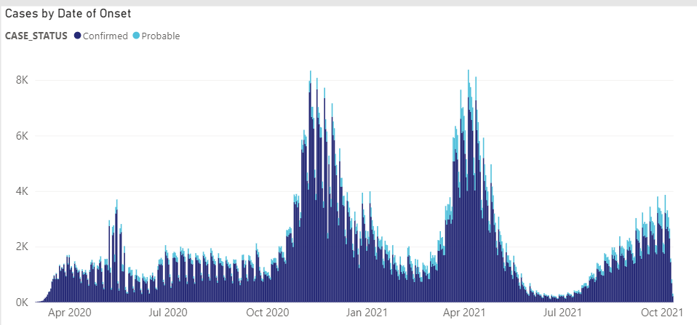
Michigan Cases by Date of Onset

Slide 5
Rolling 7-day averages from 10/11/2021
County | Jackson | Macomb | Oakland | Wayne
Community transmission | High | High | High | High
Case rate | 263.71 / 100K ↓4.57% | 261.79 / 100K ↑16.68% | 219.71 / 100K ↑17.37% | 185.9 / 100K ↑20.94%
Percent COVID tests positive | 10.5% ↑0.4% | 10.08% ↑1.68% | 7.4% ↑1.1% | 4.06% ↑0.41%
New COVID admissions | 5.99 / 100 beds ↑13.33% | 6.32 / 100 beds ↑49.09% | 5.46 / 100 beds ↓6.46% | 4.95 / 100 beds ↑29.81%
Percent beds used for COVID | 11.49% ↑0.81% | 6.94% ↑0.75% | 6.39% 0% | 6.09% 0%
Percent ICU beds used for COVID | 18.43% 0% | 18.92% ↑2.28% | 14.63% ↑1.46% | 11.03% 0%
Percent fully vaccinated | 47.5% | 51.5% | 60.5% | 47.7%

Slide 6
What is driving COVID transmission in Michigan?
Many schools in session without requiring masks
Large number of school related outbreaks (K-12 and college)
https://www.michigan.gov/coronavirus/0,9753,7-406-98163_98173_102480---,00.html
Vaccinate rates remain low in Michigan
67.9% of eligible individuals received at least 1 dose of vaccine (16⁺ years)
57.1% of total population
58.5% of eligible individuals fully vaccinated
52.3% of total population
Public not wearing masks indoors – CDC recommends everyone wears a mask indoors when there is a high level of transmission regardless of vaccination status
COVID variants – more on this later
https://healthdata.gov/Community/COVID-19-State-Profile-Report-Michigan/s8hn-gz3c
https://www.michigan.gov/coronavirus/0,9753,7-406-98178_103214_103272-547150--,00.html

Slide 7
COVID Treatments
Outpatient
Monoclonal antibody treatment
Oral pill in development
FDA application for emergency use authorization submitted by manufacturer
Molnupiravirz: stops RNA transcription which is necessary to make new viruses
Inpatient
Glucocorticoids – most effective treatment (decrease inflammation which causes lung damage)
No clear benefit in outpatients – ongoing trials
Anti-clotting agents: inflammatory cascade triggers clots which can be life threatening
Remdesivir – antiviral drug with limited benefit
Immune modulators – turn off inflammatory response

Slide 8
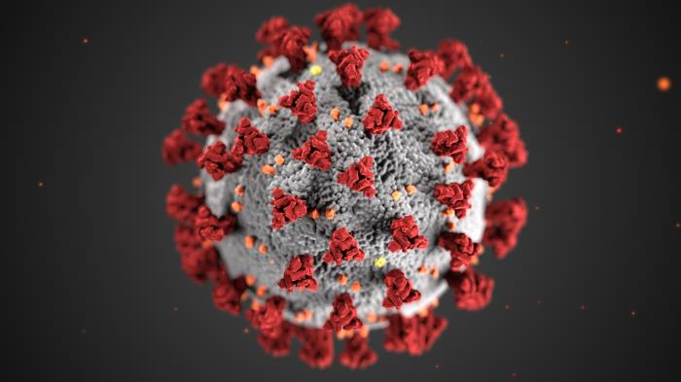
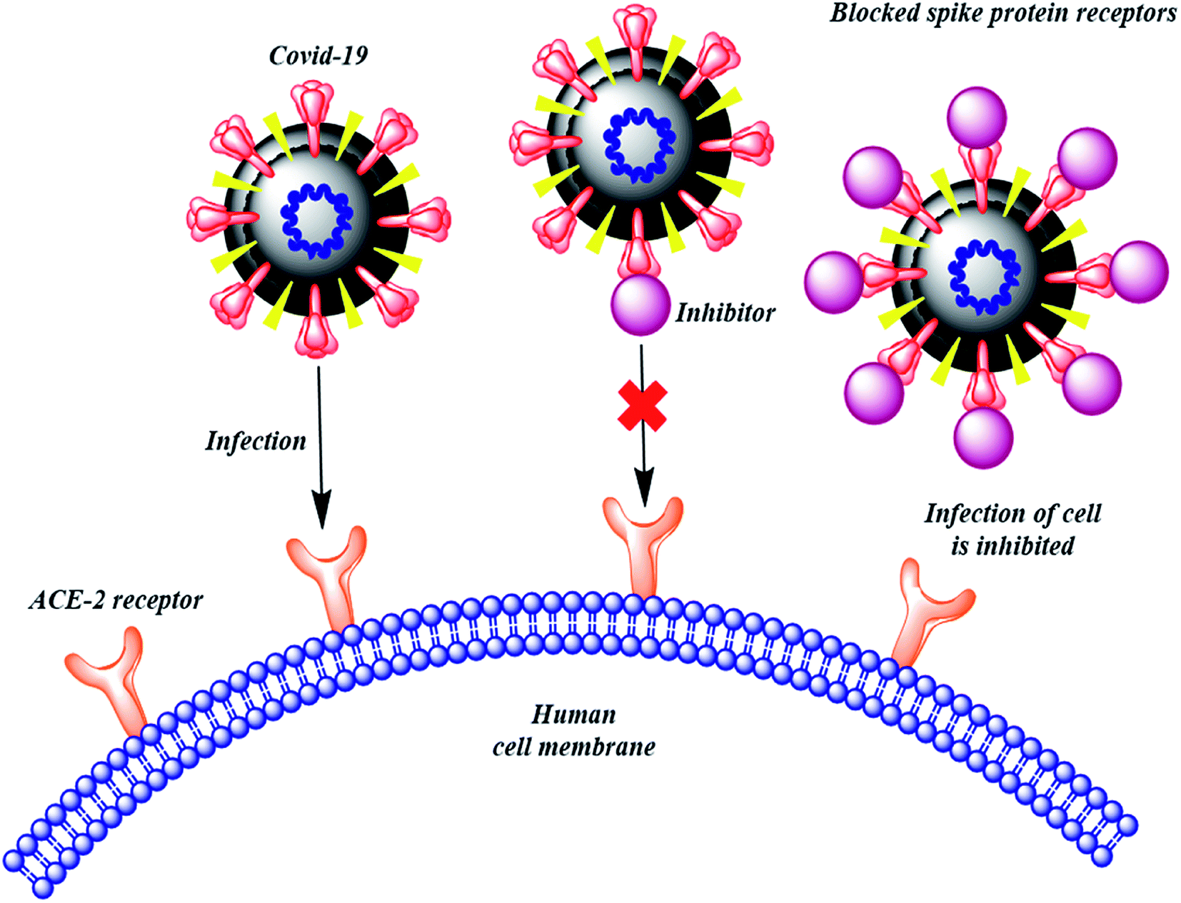
Monoclonal Antibodies
Synthetic proteins (laboratory produced) that bind to COVID-19 and help to prevent virus from entering our cells
Binds to the spike protein of coronavirus
Inhibits spike protein from binding to ACE-2 receptors
Prevents infection
https://www.nature.com/articles/s41467-020-18319-6

Slide 9
Monoclonal antibodies continued
Effective in treating COVID infections in people at high risk for severe COVID disease
Use before patients need extra oxygen
Can prevent disease in people at high risk for severe COVID disease after an exposure (prophylaxis)
Can administer via Intravenous route or subcutaneous injections
Henry Ford administered drug to more than 1,100 people in September
https://www.henryford.com/coronavirus/covid19-symptoms-testing-treatment/monoclonal-antibody-treatment

Slide 10
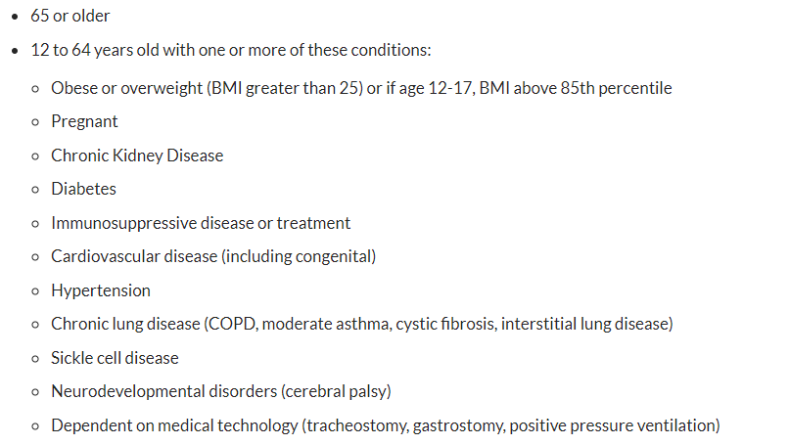
Risk factors for severe COVID disease

Slide 11
Natural infection versus vaccination
When COVID-19 first hit the U.S., re-infection extremely unlikely within 90 days of infection
Natural infection
antibodies may not be detected after 90 days
If mild infection, antibodies may not be detected after 60 days
Not everyone that had COVID infection will produce antibodies
36% of people did not have detectable antibodies after infection
Usually in younger adults with mild disease (lower levels of virus in nose)
Antibodies after vaccination remain at high levels for 180 days
Longer duration than antibodies after natural infection
Better protection against variants
https://wwwnc.cdc.gov/eid/article/27/9/21-1042_article

Slide 12
Breakthrough disease after infection
Data shows that COVID breakthrough infections in 2.6% of vaccinated healthcare workers based on Israeli data
33% had no symptoms
67% had mild symptoms
Israel used Pfizer vaccine
No breakthrough cases of severe disease
Death
Hospitalization
Other data suggests vaccinated individuals shed virus at lower amounts for shorter duration of time compared to non-vaccinated individuals
https://www.nejm.org/doi/full/10.1056/NEJMoa2109072?query=featured_home

Slide 13
COVID-19 vaccines in the U.S.
Pfizer
Full approval to prevent infection in people 16 years of age and older (2 doses)
Emergency Use Approval
Children 12 to 11 years of age (2 doses)
3rd dose
Age 65 and older
High risk for severe COVID disease
Anyone with occupational exposure
Moderna Emergency Use Approval to
prevent COVID in people 18 years of age and older (2 doses)
3rd dose for people with moderate to severe immunocompromise
J&J Janssen
Prevent COVID in people 18 years of age and older (1 dose)

Slide 14
Next Steps for Vaccines
October 14 & 15: FDA will vote on approving booster doses for Moderna and J&J Janssen vaccines
Moderna 3rd dose authorized only for immunocompromised adults
October 20 & 21: ACIP (Advisory Committee on Immunization Practices) votes on FDA actions
ACIP vote required for ‘official recommendation”
October 26: FDA votes on approving Pfizer vaccine for children 5 – 11 years
ACIP votes on November 2 & 3

Slide 15
COVID-19 variants
Like influenza, COVID-19 mutates
Each new variant takes ‘old’ mutations and adds additional mutations
Delta incorporated mutations from 2 different variants – first time virus incorporated both mutations which made the virus much more contagious
251 times higher level of Delta in nose versus original COVID-19 virus
Variants of Concern (4): public health threat because mutations make virus more contagious, more virulent, or resistant to antibodies
Variants of Interest (3): potential public health threat
Variants under Monitoring (>20): not believed to have broad public health threat

Slide 16
Variants of Concern
WHO designation | Pango lineage | Origin | Date
Alpha | B.1.1.7 | United Kingdom | 9/2020
Beta | B.1.351 | South Africa | 5/2020
Gamma | P.1 | Brazil | 11/2020
Delta | B.1.617.2 | India | 10/2020

Slide 17
Variants of Interest
WHO designation | Pango lineage | Origin | Date
Lambda | C.37 | Peru | 12/2020
Mu | B.1.621 | Columbia | 1/2021
Not designated | B.1.620 | First identified in Lithuania, but likely origin in Cameroon | 4/2021

Slide 18
When will this pandemic end?
Depends on future variants
Could a new variant change proteins enough that antibodies no longer effective
Wipe out any protection from vaccine or prior infections
Vaccine uptake by the general population (primary series and boosters)
Population’s behaviors
Prevention (masks, social distancing) versus ‘back to normal’

