Slide 1
Testing Rules for Paper-Based FSA & Statewide Science Assessments
Updated Spring 2022

Slide 2
It’s almost time to take the FSA and Science Assessments!
Here are some important reminders to help you follow the rules and do your very best.

Slide 3
Test Invalidation
Let’s talk about the term test invalidation.
It’s important for you to understand what it means so it won’t happen to you!

Slide 4
Test Invalidation
If your test is invalidated,
it means that your test will not be scored,
and you will not be able to retake the same test during this window.

Slide 5
1. Remove all electronic devices.
To make sure your test is scored…
If you have an electronic device
at your desk,
in your pocket,
or anywhere you can reach it during testing or while on a break,
your test will not be scored.

Slide 6
Electronic Devices Include:
Electronic Devices Include:
Cell phones or smartphones
Smartwatches
Handheld video games and tablets
Cameras
Bluetooth/ wireless headphones/ earbuds

Slide 7
Electronic Devices
Electronic Devices
Your teacher may collect electronic devices
or instruct you to put them away (in a locker or backpack away from your desk).
If you aren’t sure if something is an electronic device, please ask your teacher before the test.

Slide 8
2. Do your own work.
If you are caught
looking at another student’s answers,
allowing another student to look at your answers,
or using any kind of unauthorized aid during the test,
To make sure your test is scored…
your test will not be scored.

Slide 9
3. Don’t be disruptive.
To make sure your test is scored…
It is very important for you to
remain quiet,
respect other students,
and pay attention to and follow the instructions.
If you are disruptive during a test, you may be dismissed from the room, and your test may not be scored.

Slide 10
4. Don’t leave school during a test session.
To make sure your test is scored…
If you leave the school’s campus for
lunch,
or an appointment,
before you complete a test session,
you will not be allowed to finish taking the test when you return.

Slide 11
Taking the Test
Let’s talk
about the rules during the test
and how to set yourself up for success!

Slide 12
During the test, you may not…
Look at another student’s test and answer book or test materials.
Allow another student to look at your test and answer book or test materials.
Give help to another student in answering test questions.

Slide 13
During the test, you may not…
Have notes or use other materials not provided by the test administrator.
Have electronic devices in your possession at any time, including breaks, even if you do not use them.

Slide 14
During the test, you may not…
Talk to other students
Make any disturbance

Slide 15
Testing Rules Acknowledgement
On the day of the test, your test administrator will read the testing rules (that were just covered in this presentation) aloud and ask you to read the Testing Rules Acknowledgment.
You will be asked to sign your name below the Testing Rules Acknowledgment to show that you understand the rules.

Slide 16
Marking Your Answers
Now it’s time to review some important tips for marking your answers correctly.

Slide 17
Marking Your Answers
You are allowed to…
circle or underline words in the reading passages or questions,
or make notes in the blank space in your test and answer book.

Slide 18
Marking Your Answers
ü
For questions that ask you to fill in a bubble or bubbles, be sure to fill in the bubble for your answer choice or choices completely with your Number 2 pencil.

Slide 19
Marking Your Answers
Circle the bubble
For answers that require you to fill in a bubble or bubbles, do not:
x
x
Fill the bubble incompletely
x
x
x
x
x
x
Cross out or draw an X on the bubble

Slide 20
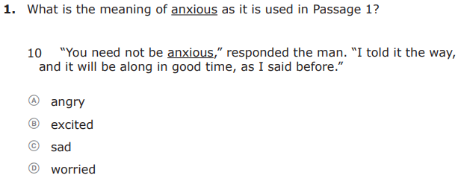
Marking Your Answers
Make sure that any marks you make taking notes do not go into a bubble that is not your answer.
x

Slide 21
Marking Your Answers
If you change an answer, be sure to erase completely.
If you use your eraser, do so gently to avoid ripping or tearing your test.

Slide 22
Taking the Writing Test
Let’s talk
about the materials you will use to take the test
and the process you will follow when taking the test!

Slide 23
FSA ELA Writing
Students in grades 4–6 will take the ELA Writing assessment on paper.
There is one 120-minute session for ELA Writing.
You will complete the session in one school day.

Slide 24
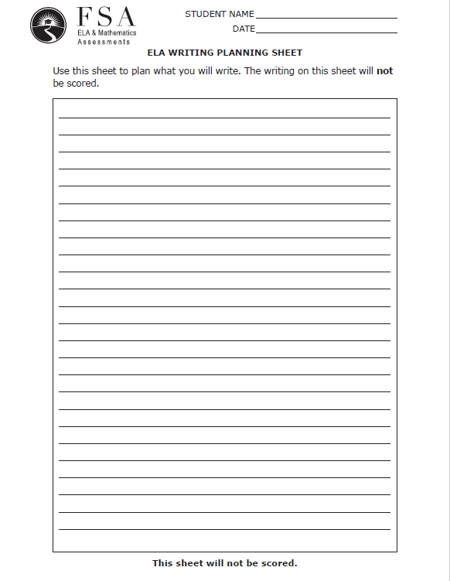
Writing Test: Planning Sheet
Before you begin, your test administrator will give you a Planning Sheet that you may use to take notes and plan your writing.
While testing, make sure that your planning sheet is not easily visible to other students.
Your test administrator will collect your planning sheet at the end of the test.

Slide 25
Writing Test: Test and Answer Books
You will receive an FSA ELA Writing test and answer book that contains reading passages, a writing prompt, and three lined pages where you will write your response.
Make sure you write inside the box that contains the lines.

Slide 26
Taking the Writing Test
Your writing should show that you can organize and express your thoughts clearly.
Read each passage carefully and respond completely to the writing prompt.
You are required to write your response in English.

Slide 27
Taking the Writing Test
Manage your time carefully so that you have time to…
write your response on the lined pages,
read the passages,
and proofread, revise, and edit your response.
plan your response,

Slide 28
Taking the Reading Test
Let’s talk
about the materials you will use to take the test
and the process you will follow when taking the test!

Slide 29
FSA ELA Reading
Students in grades 3–6 will take the ELA Reading assessment on paper.
There are two sessions for ELA Reading; you will complete the sessions over two days.
Grades 3–5 students will have 80 minutes for each session and will answer around 30 questions per session.
Grade 6 students will have 85 minutes for each session and will answer around 30 questions per session.

Slide 30
Taking the Reading Test
Pay attention to the directions so you know how to respond to the question.
Read each passage carefully.
Try to answer every question.

Slide 31
Taking the Reading Test
If you come to a page in your test and answer book that says Go On in the bottom corner, turn the page and continue working.

Slide 32
Taking the Reading Test
When you come to the stop sign at the end of a session, stop working.
Do not go on to the next session.

Slide 33
Taking the Reading Test
When you have finished a session,
and that you have answered every question.
check through your answers for that session to make sure you have answered each question in the way you were supposed to

Slide 34
Taking the Mathematics Test
Let’s talk
about the materials you will use to take the test
and the process you will follow when taking the test!

Slide 35
FSA Mathematics
Students in grades 3–5 will take the Mathematics assessment on paper.
Students in grade 6 will take the Mathematics assessment on paper.
Students in grades 3–5 will complete the FSA Mathematics assessment over two days.
Students in grade 6 will complete the FSA Mathematics assessment over two days.
Grades 3–5 students will have two sessions. Each session will last 80 minutes, and you will answer around 30 questions per session.
Grade 6 students will have three sessions. Each session will last 60 minutes, and you will answer around 20 questions per session.
You will take Session 1 on Day 1 and Session 2 on Day 2.
You will take Session 1 on Day 1 and Sessions 2 and 3 on Day 2.

Slide 36
Taking the Mathematics Test
Pay attention to the directions so you know how to respond to the question.
Read each question carefully.
Try to answer every question.

Slide 37
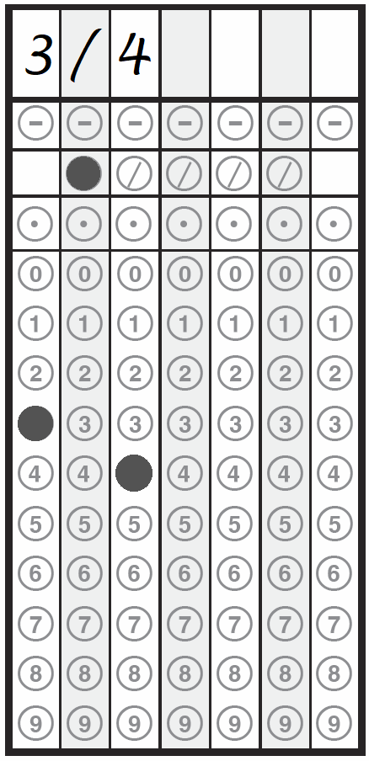
Gridding Responses
First, write the number clearly.
Then, fill in the bubbles.
ü
Always fill in the bubbles underneath.
Be sure to check you have bubbled the correct numbers or symbols.
Note: This example uses the 6th grade grid.

Slide 38
Gridding Responses
Write only one digit or symbol per box.
ü
x

Slide 39
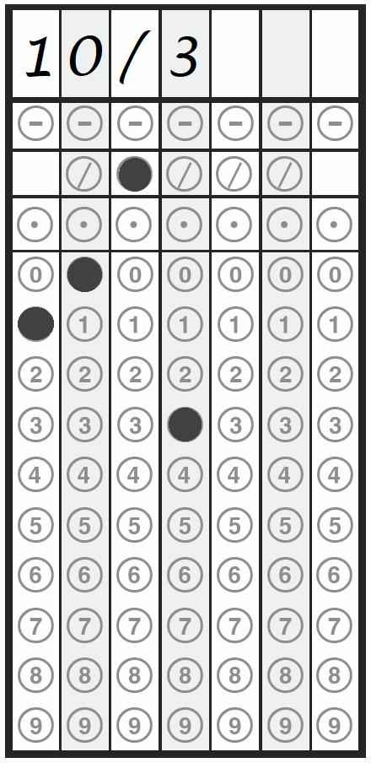
Gridding Responses
Remember to always represent fractions greater than 1 in the form a /b (not mixed numbers).
3 ¹/₃ = 10/3
ü
Note: This example uses the 6th grade grid.

Slide 40
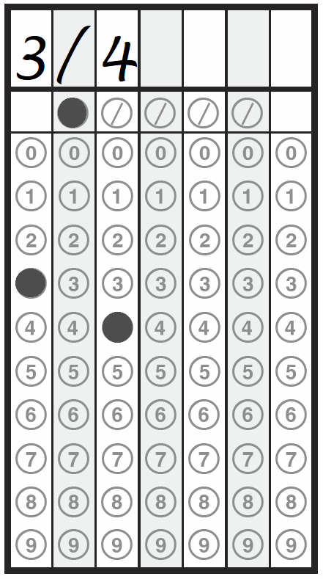
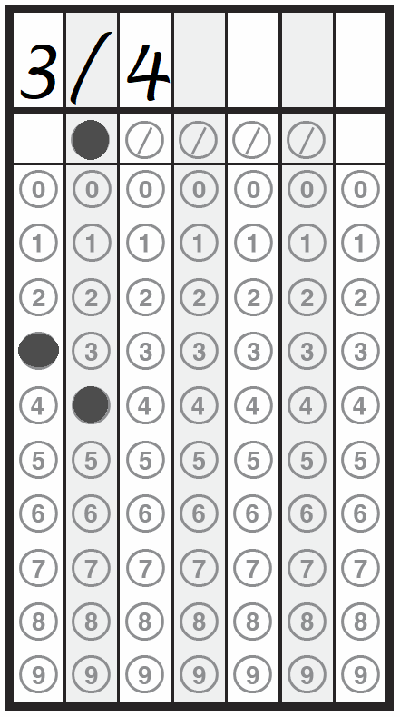
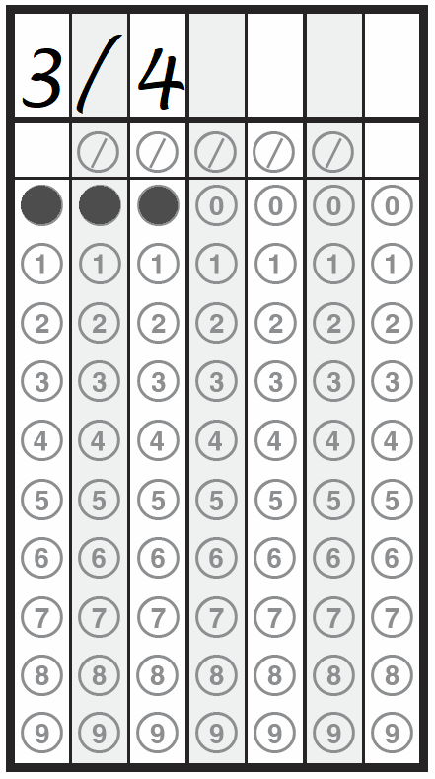
Gridding Responses
ü
x
x
Fill in only one bubble per column,
and make sure the bubbles match what is written in the boxes.
Note: This example uses the 3rd grade grid.

Slide 41
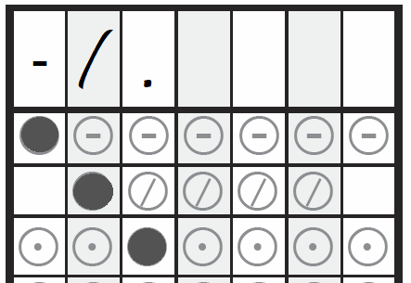
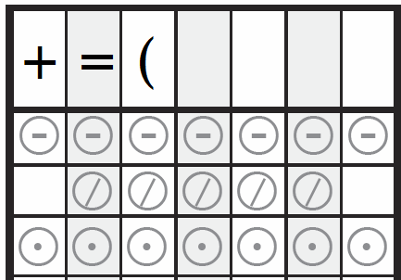
Gridding Responses
ü
Use only the symbols available on the grid in the boxes.
x
Note: This example uses the 6th grade grid.

Slide 42
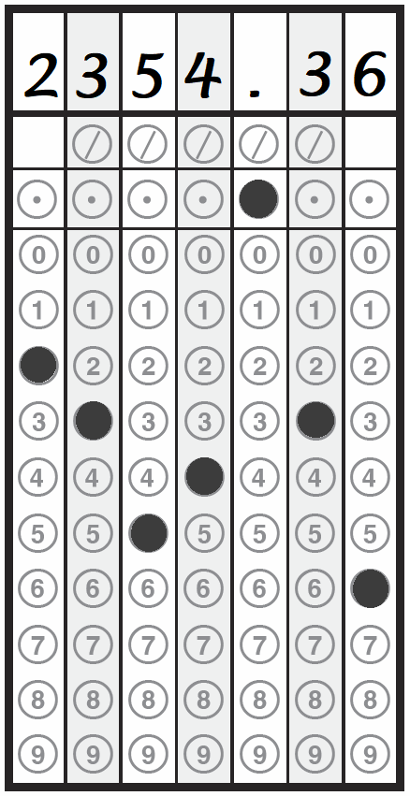
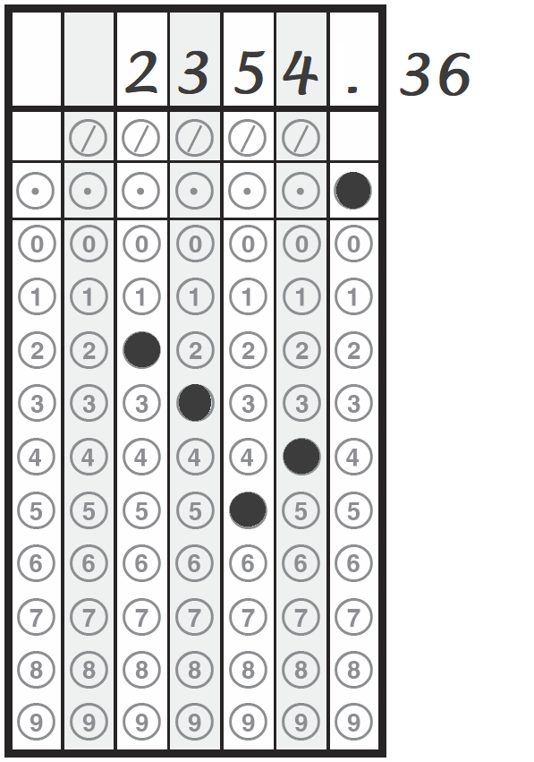
Gridding Responses
Use
ü
only
x
the
space
provided.
Note: This example uses the 4th and 5th grade grid.

Slide 43
Taking the Mathematics Test
If you come to a page in your test and answer book that says Go On in the bottom corner, turn the page and continue working.

Slide 44
Taking the Mathematics Test
When you come to the stop sign at the end of a session, stop working.
Do not go on to the next session.

Slide 45
Taking the Mathematics Test
When you have finished a session,
and that you have answered every question.
check through your answers for that session to make sure you have answered each question in the way you were supposed to

Slide 46
Taking the Science Test
Let’s talk
about the materials you will use to take the test
and the process you will follow when taking the test!

Slide 47
Statewide Science
Students in grade 5 will take the Statewide Science test on paper.
Students in grade 8 will take the Statewide Science test on paper.
Students in grade 5 will complete the Statewide Science test over two days.
Students in grade 8 will complete the Statewide Science test in one day.
Grade 5 students will have two sessions. Each session will last 80 minutes, and you will answer around 30 questions per session.
Grade 8 students will have two sessions. Each session will last 80 minutes, and you will answer around 30 questions per session.
You will take Session 1 on Day 1 and Session 2 on Day 2.
You will take both sessions in one day. Session 2 will be administered after a break.

Slide 48
Taking the Science Test
Pay attention to the directions so you know how to respond to the question.
Read each question carefully.
Try to answer every question.

Slide 49
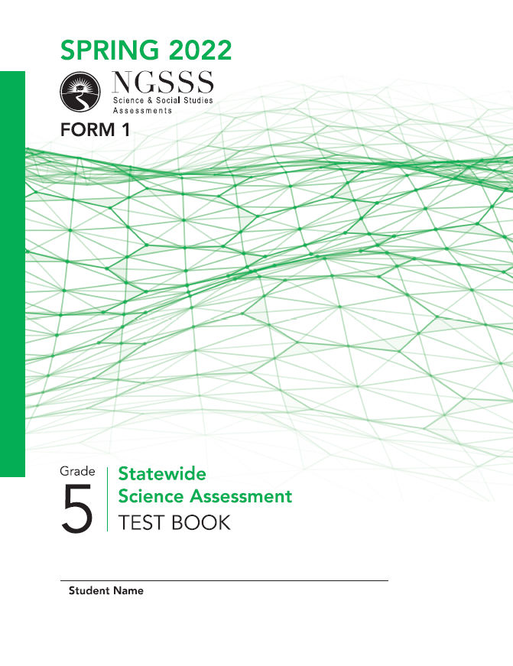
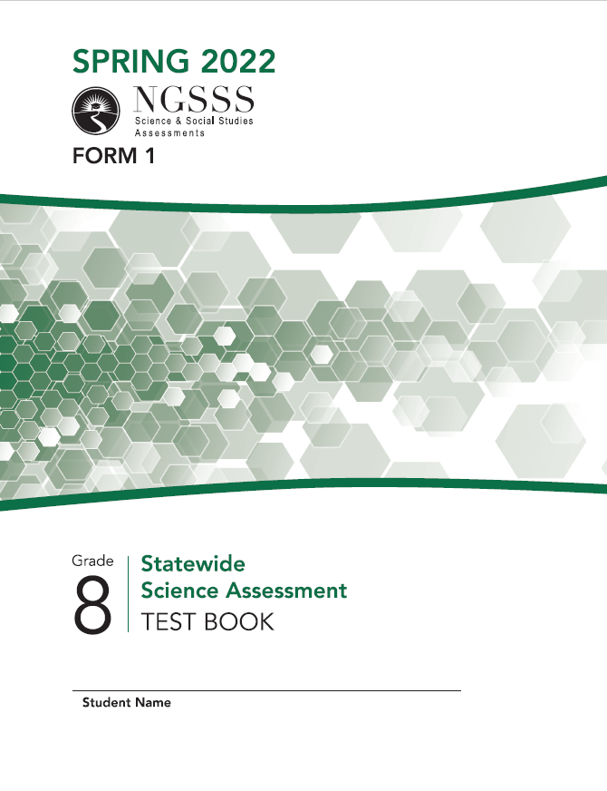
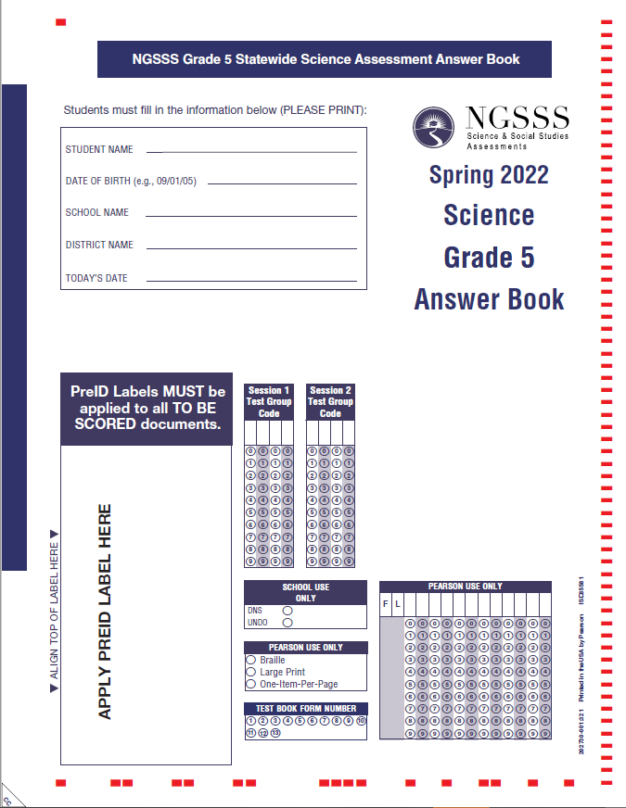
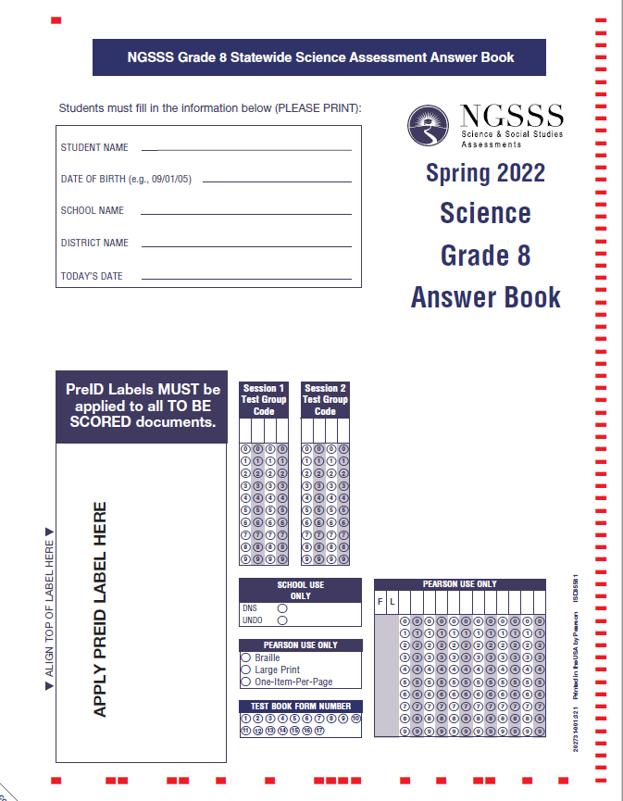
Taking the Science Test
Unlike some of the other assessments you will take, for Science,
you will read the items in the test book
and mark your answers in the answer book.

Slide 50
Marking Your Answers
ü
All of the questions on the Science test are multiple choice, so be sure to fill in the bubble for your answer choice completely with your Number 2 pencil.

Slide 51
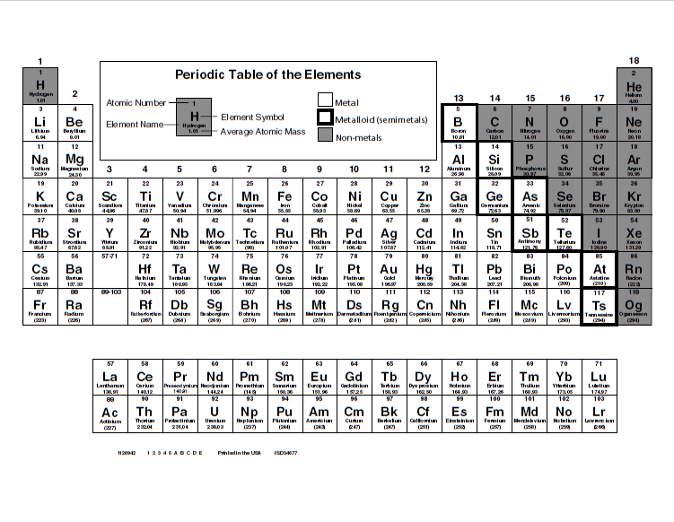
Grade 8 Science Test:
Periodic Table of the Elements
Before you begin, your test administrator will give you a Periodic Table of the Elements that you may reference during your test.
While testing, make sure that your Periodic Table is not easily visible to other students.
Your test administrator will collect your Periodic Table at the end of the test.

Slide 52
Testing Rules
Remember…
Do not provide help in answering test questions.
Do not ask for help in answering any test questions.
Use only approved materials for taking notes.
Do not have access to or use any electronic or recording devices at any time during the test session, including during breaks.
Do not look at another student’s test materials.
Do not talk to other students or make any disturbance.
You may not have a cell phone during testing.

Slide 53
Remember…
or changing any answers from a previous session.
For example: working ahead in Session 2 during Session 1 of the test,
or going back and working in Session 1 during Session 2 of the test,
Work in another session.
During the test, you may not:

Slide 54
Remember…
You may not ask for help in answering any test questions or planning your responses.
Your teacher or test administrator is not allowed to discuss the test or help you read, understand, or answer test questions.
Try to answer every question or respond completely.

Slide 55
Remember…
Be sure to read and revise your response or check your answers and try to answer every question before turning in your test.
Once you finish and turn in your materials, you may not ask for them back.

Slide 56
Remember…
During breaks and after testing, it’s important that you don’t talk about the specific test questions, responses, or passages with friends, classmates, teachers, or other students.

Slide 57
Last But Not Least…
Get a good night’s sleep.
Relax and do your best!
Eat a good breakfast before the test.

