Slide 1
Tips for Taking the Computer-Based FSA ELA Reading Assessment
Grades 7–10 Reading
Updated Spring 2022

Slide 2
It’s almost time to take the FSA ELA Reading Assessment!
Here are some important explanations and reminders to help you do your very best.

Slide 3
But first, let’s talk about…
the rules you will follow during the test,
the materials you will use to take the test,
and the process you will follow when taking the test.

Slide 4
Testing Rules
Remember…
Do not provide help in answering test questions.
Do not ask for help in answering any test questions.
Use only approved materials for taking notes.
Do not have access to or use any electronic or recording devices at any time during the test session, including during breaks.
Do not look at another student’s test materials.
Do not talk to other students or make any disturbance.
You may not have a cell phone during testing.

Slide 5
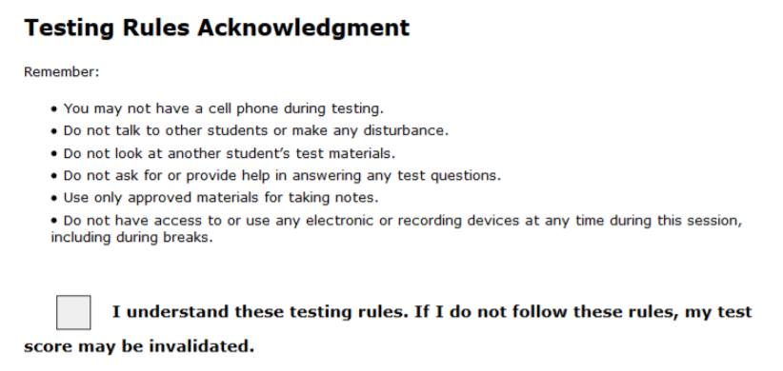
Testing Rules Acknowledgement
On the day of the test, your test administrator will read the testing rules (that were just covered in this presentation) aloud and ask you to read the Testing Rules Acknowledgment.
You will be asked to select a box next to the Testing Rules Acknowledgment to show that you understand the rules.

Slide 6
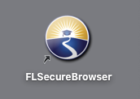
FL Secure Browser
You will take the test in the Secure Browser.

Slide 7
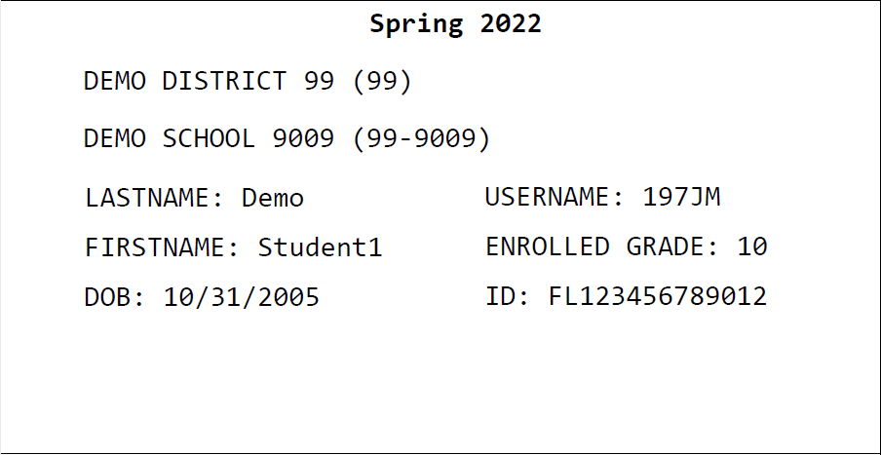
Test Tickets
Prior to testing, your test administrator will give you a test ticket listing your First Name and Username, which you will need to log in to your computer-based test.
Tell your test administrator if you have any issues with your ticket.
Be sure that your test ticket has the correct name and date of birth on it.

Slide 8
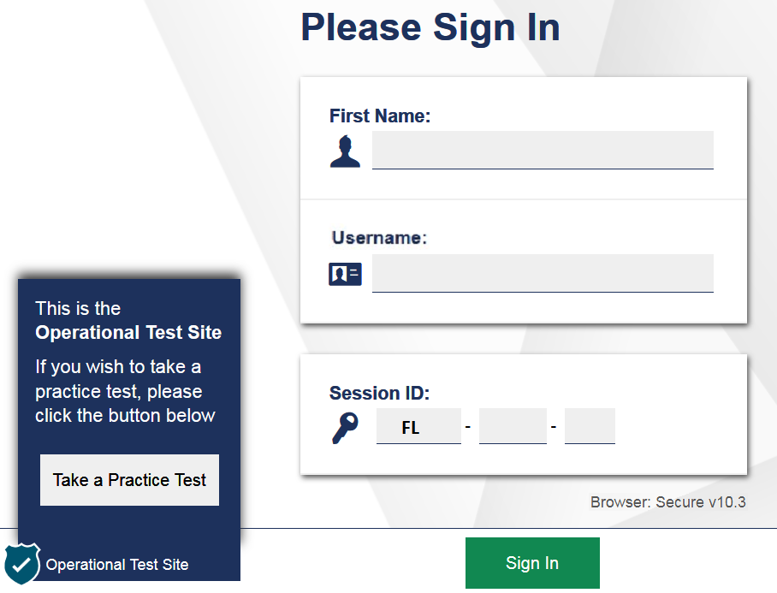
Logging In to the Test
When your test administrator tells you to do so, enter your First Name and Username exactly as they appear on your test ticket.
Next, enter the Session ID, which your test administrator will display for you.

Slide 9
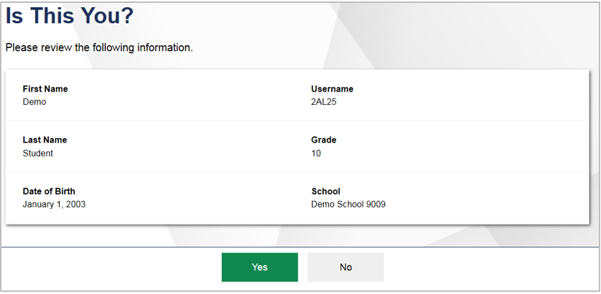
Is This You? Screen
After you log in, you will see a screen that says Is This You?
Verify that the information listed on the screen is correct and select Yes to continue.

Slide 10
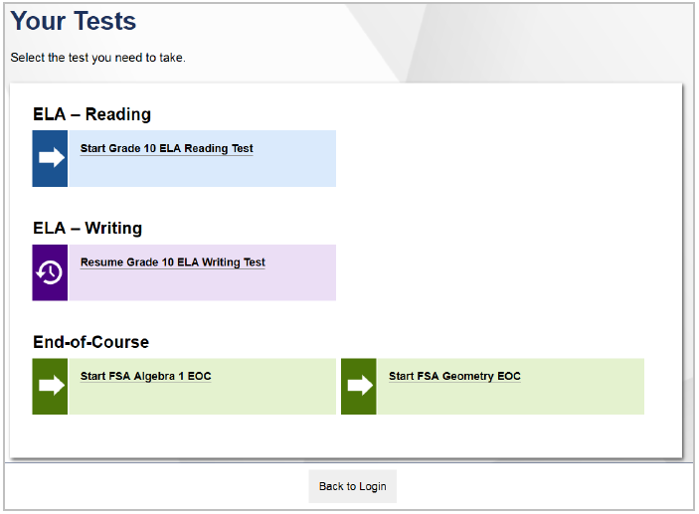
Your Tests Screen
After you confirm your identity, the Your Tests screen appears.
Start in front of the test name indicates you will be starting the test.
Only tests that the Test Administrator has selected will appear on the Your Tests screen.
Resume in front of the test name indicates you will be resuming the test. This is what you will see between Session 1 and Session 2, for example.
Available tests are in color and indicate whether you will be starting a new test or resuming a test.

Slide 11
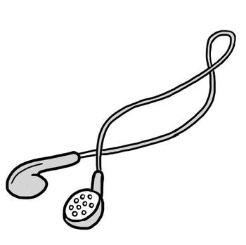
Headphones/Earbuds
During testing, you will use headphones or earbuds to access audio content on the FSA ELA Reading test.
When you log in to take your test, you will listen to a sound check to ensure that your headphones or earbuds are working prior to beginning the test.

Slide 12
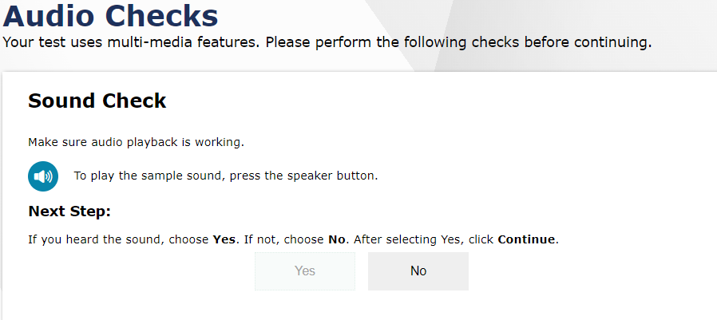
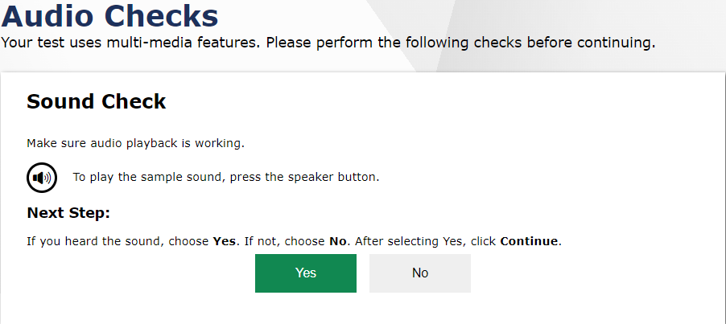
Audio Checks Screen
This is the Audio Checks screen.
First, put on your headphones or earbuds.
Next, you will click the speaker icon and listen to the audio.
If you heard the sample audio, press Yes. The Before You Begin screen will appear.

Slide 13
Computer-Based Tools
You may use any of the tools on the screen to help you with your test.

Slide 14
Computer-Based Tools
Back and Next
Zoom Out and Zoom In
The Back and Next buttons can be used to move to the previous question or the next question.
Use the Zoom Out and Zoom In buttons to decrease and increase the size of text within the test page. Four levels of magnification are available.

Slide 15
Computer-Based Tools
Save
Pause
The Save button allows you to manually save your work. However, this feature is optional.
The Pause button allows you to pause and exit the test. If you pause your test, you will have to log back in to the testing system to resume testing.
Your responses will save automatically every time you move to the next item regardless of whether you select the Save button.

Slide 16
Computer-Based Tools
End Test
You will only select the End Test button when you are completely finished with your test and ready to submit.

Slide 17
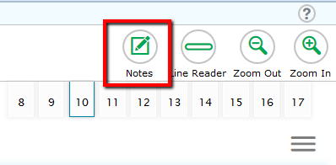
Computer-Based Tools
Notes
The Notes tool opens a pop-up window in which you can type notes for later reference.
There is one notepad for the entire test. The notes you type will remain each time you open the tool unless you delete them.
Remember, you can also make notes on your CBT Worksheet.

Slide 18
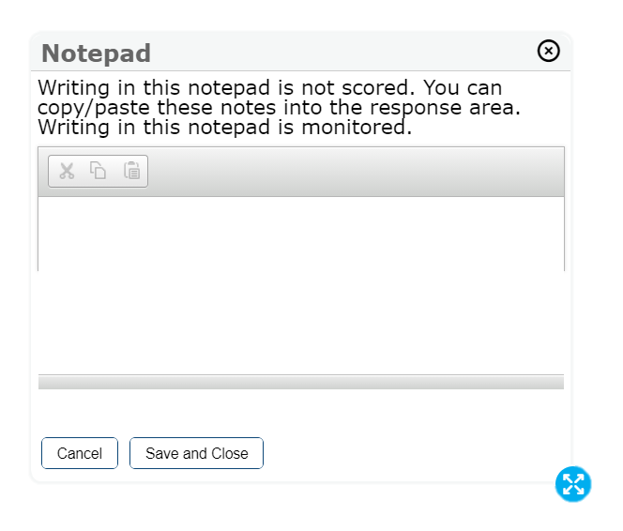
Computer-Based Tools
Notepad
The notes you type are not scored as a part of your test, but they are monitored by the testing contractor.
You can move the Notepad around the screen by clicking the top of the window and dragging it to another part of the screen.

Slide 19
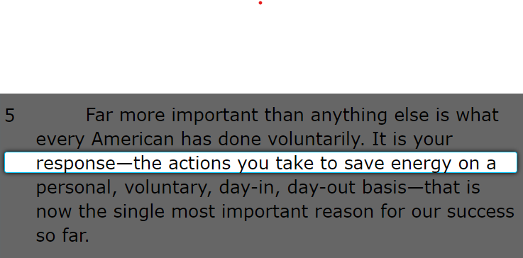
Computer-Based Tools
Line Reader
Highlighter
With the Highlighter tool, you can highlight sections of the passages and items by using your mouse to click and drag from the beginning to end of the section you want to highlight.
The Line Reader tool allows you to emphasize a specific line of text in the question or passage to make it easier to read.

Slide 20
Computer-Based Tools
Expand/Collapse Panel Tool
The Expand/Collapse Panel tool allows you to expand the reading passage or the item panel so that it takes up most of the screen.

Slide 21
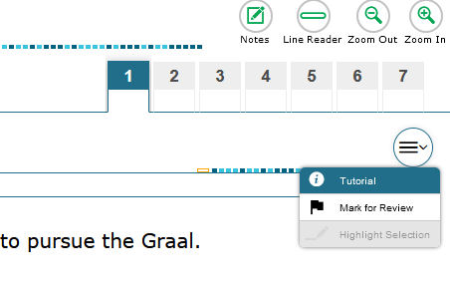
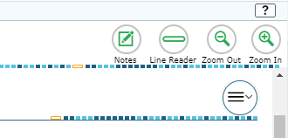
Computer-Based Tools
Context Menu: Tutorial
Help Tool
The Tutorial tool opens a pop-up window that will display a video tutorial of how to respond to that particular item type.
*Note that there is no sound for the tutorial.
The Help tool opens a pop-up window which will remind you how to navigate from one item to the next and how to use the tools and features in the testing platform.

Slide 22
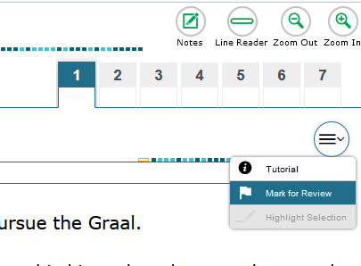
Computer-Based Tools
Context Menu: Mark for Review
This tool allows you to flag, or mark, an item to review later.
The Review screen at the end of the test will alert you to any items that you have marked for review so that you can go back and check your work for those items.

Slide 23
Skipping Items
If you want to skip an item and return to it later, this pop-up window will appear when you move to a new passage set.
Remember to use the Mark for Review tool for any items you skip.
If you meant to skip an item, select Yes. If you thought you answered all the items, select No and make sure you have responded to all parts of each item.

Slide 24
Computer-Based Tools
Item Summary Drop-Down
Another way to navigate!
The Item Summary Drop-Down list opens a menu which shows you a quick summary of the test items you’ve viewed as well as any items marked for review or those unanswered. You can click any item number to navigate to that item.

Slide 25
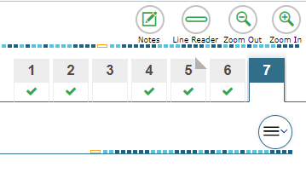
Computer-Based Tools
Passage Panel
In addition to Back and Next and the Item Summary Drop-Down, clicking on the numbers in the Passage Panel also allows you to navigate back and forth between test items.
Unanswered item
The green checkmark indicates an answered item, while the blank area under the number shows an unanswered item.
Answered item
Item Marked for Review
If the corner of the number is folded down, that’s an item you have marked for review.

Slide 26
Computer-Based Tools
Note: this tool does not remove answer choices that have been selected.
To unselect an answer choice, click it again.
Strikethrough Tool
Right-click the option you wish to cross out and choose Strikethrough;
or select Strikethrough in the Context menu and click on the option.
You can use the Strikethrough tool on multiple-choice and multiselect items to cross out options you think are incorrect.

Slide 27
FSA ELA Reading
Students in grades 7–10 will take the ELA Reading assessment on the computer.
There are two sessions for ELA Reading; you will complete the sessions over two days.
Grades 7–8 students will have 85 minutes for each session and will answer around 30 questions per session.
Grades 9–10 students will have 90 minutes for each session and will answer around 30 questions per session.

Slide 28
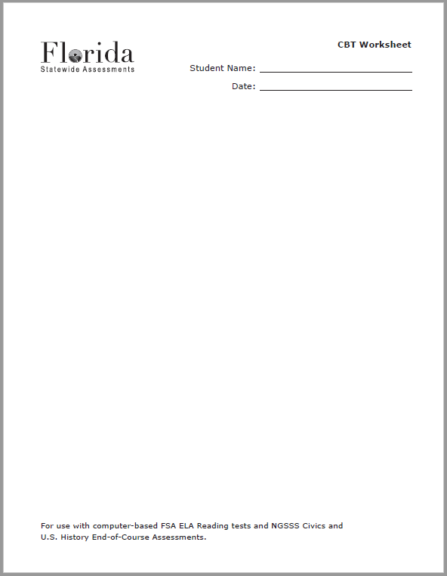
CBT Worksheet
Before you begin, your test administrator will give you a CBT Worksheet that you may use to take notes.
While testing, make sure that your worksheet is not easily visible to other students.
When you complete the assessment, the test administrator will collect your worksheet.

Slide 29
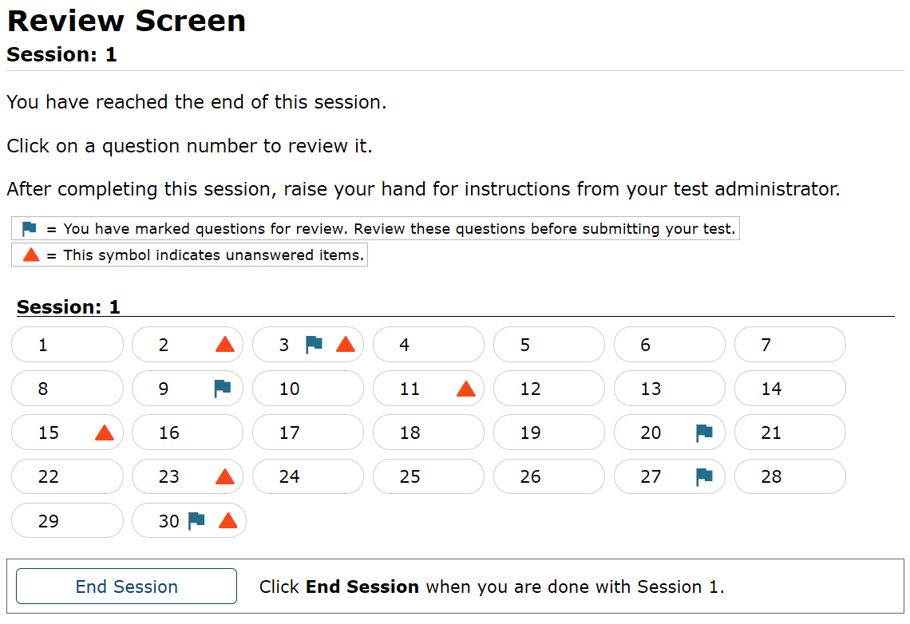
Item Review Screen
Items marked for review will have a flag next to that item number. Click the item number to return to that item to review it.
Unanswered items will have an orange triangle next to the item number. Click the number to return to that item.

Slide 30
Finishing Session 1
When you have completed Session 1, review your work carefully and ensure you have answered every question.
On the last item, select the Next button, which will take you to the Review screen.
Once you have reviewed any items, select the End Session button on the review screen.
Follow your test administrator's instructions regarding what to do if you finish your test before the session has ended.

Slide 31
Starting Session 2
You will log into Session 2 using your test ticket and a new Session ID.
You will not be able to return to Session 1.

Slide 32
Submitting Your Test
You will see a pop-up window saying that you have reached the end of the test. If you are ready to submit your test, select Yes to continue to the next screen.
After you have checked your work, select End Test.
When you have completed Session 2, review your work carefully and ensure you have answered every question.

Slide 33
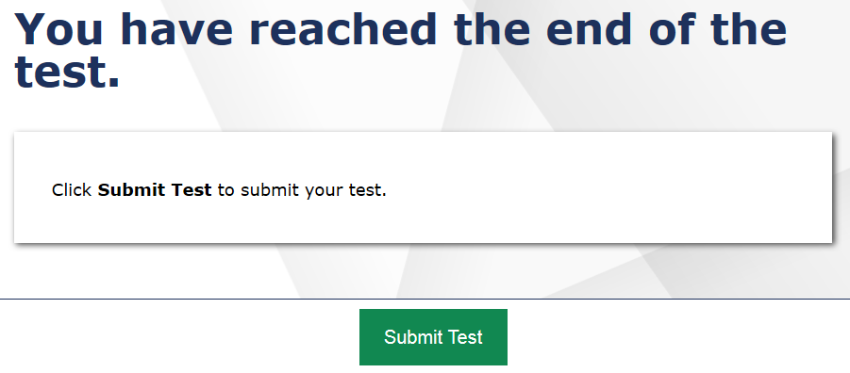
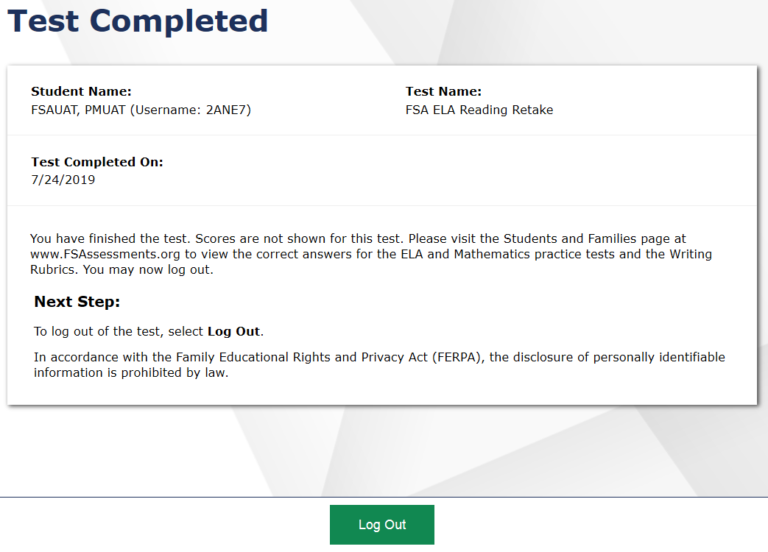
Submitting Your Test
Select Submit Test on the Submit Test screen.
Select Yes on the pop-up window that asks you to confirm that you want to submit the test.
After you have submitted your test, the Test Completed screen will appear. Click Log Out.

Slide 34
Practice Test
Before taking the “live” test, you will take a practice test.
The practice test will allow you to:
practice using the test site,
help you learn about the item types you may see,
and learn how to use the tools.
You can take a practice test any time at: https://fsassessments.org/families.html

Slide 35
In conclusion…
Thank you for following along during this presentation.
We hope you are successful on your FSA Reading assessment!
YOU CAN DO IT!
If you have any questions about the information shared with you, please be sure to ask your teacher.

