Slide 2
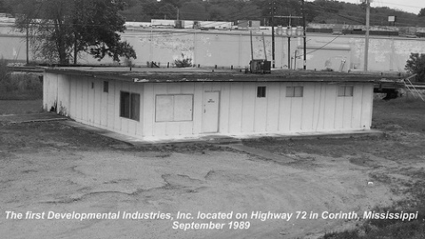
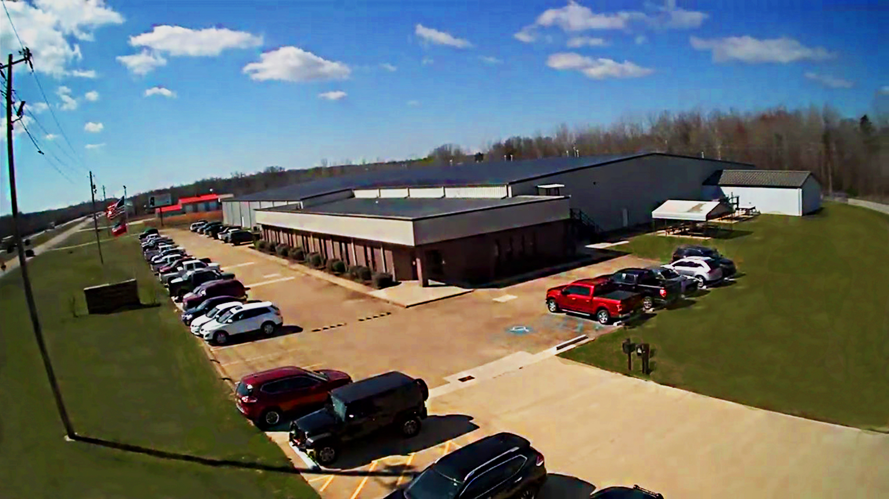
D.I. EVOLUTION
Established in 1989, we have over 30 years experience.
PRESENT…64K Sq. Ft. Manufacturing Facility and Home Office sitting on 14 acres in NE Mississippi with additional service facility in Mesa, AZ (Opened in 2015)
40+ employees
State-of-the-art Quality Control Lab and R&D Department with SolidWorks Professionals
Largest CNC machining operation in Northern Mississippi
Seamers are proudly engineered and built in our Corinth, MS manufacturing facility
D.I. is now the largest dedicated roof seamer manufacturer in the world
Partnered with over 100 panel manufacturers and suppliers

Slide 3
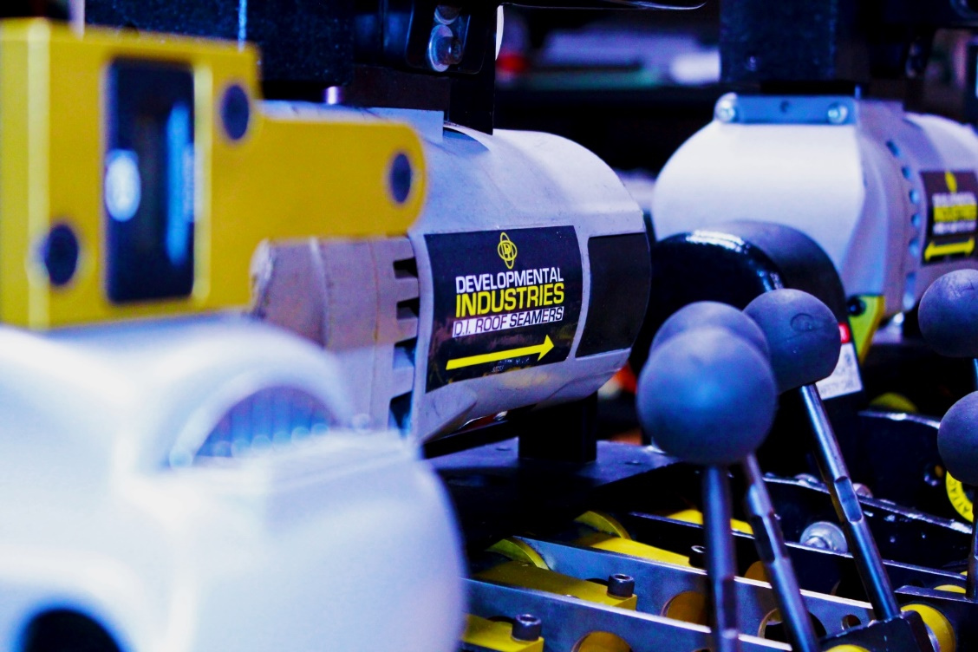
STANDARD RENTAL PROCESS
Associate I
CSR Receives/Processes Order
Associate II
Testing/Certification
Final Inspection
Shipping

Slide 4
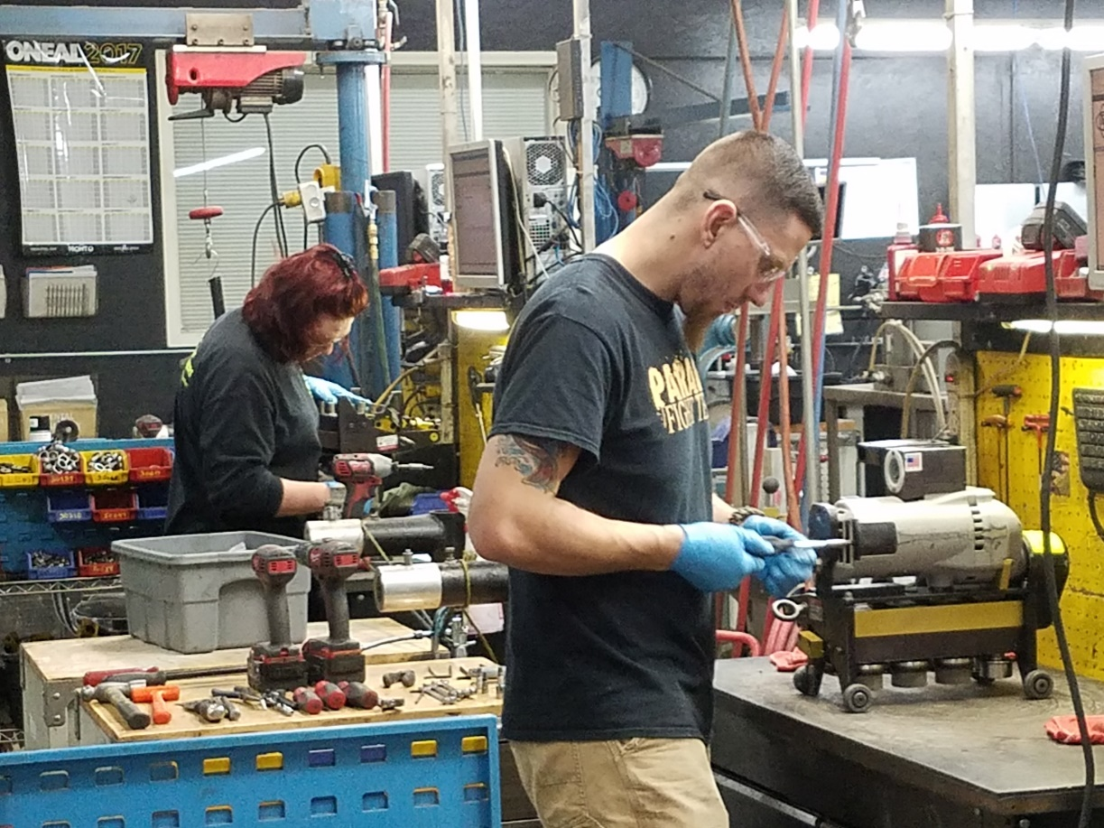
ASSOCIATE I CLEAN-UP AND INSPECTION
Every seamer is disassembled when it returns to us from the jobsite.
Tooling is removed, chassis component parts and tolerances are checked and serviced.
Tooling is cleaned and tolerances are checked for pass/fail. Depending on results, tooling is returned to inventory or recycled.

Slide 5
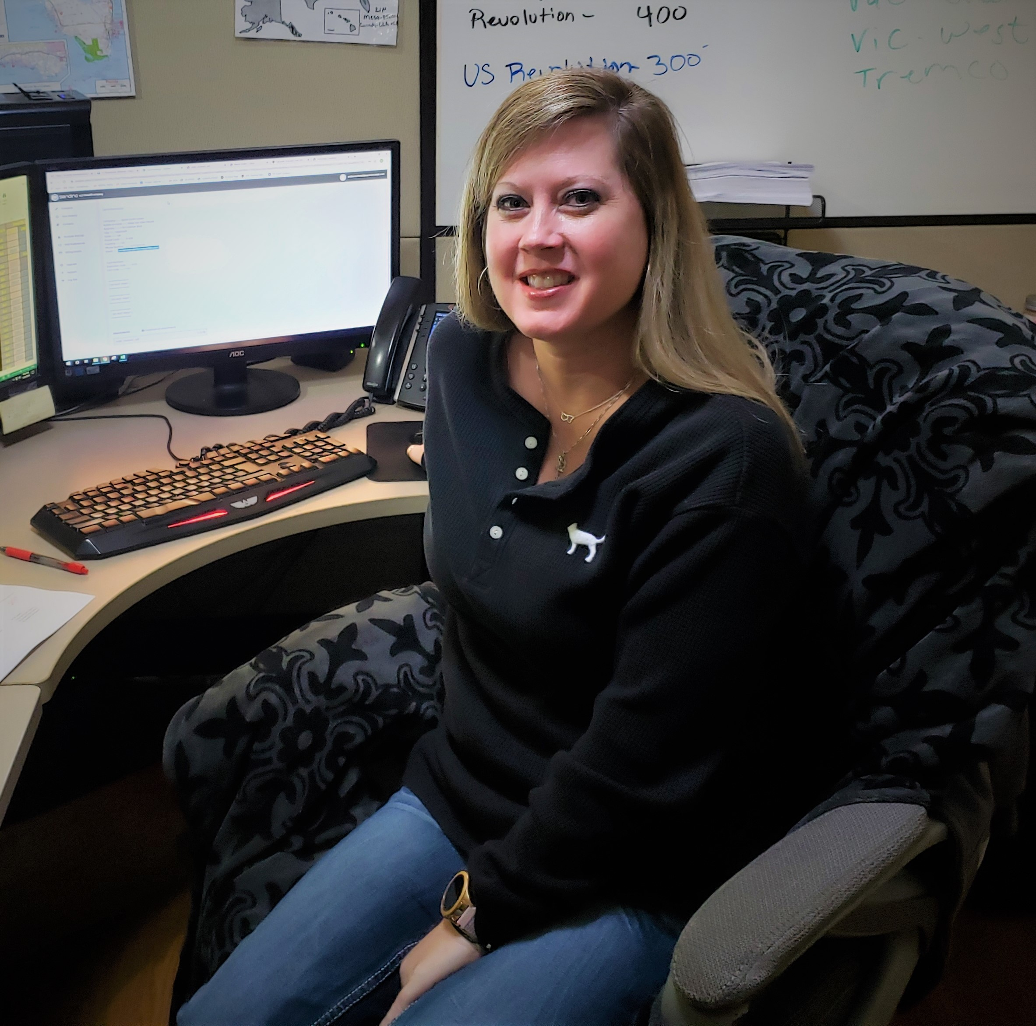
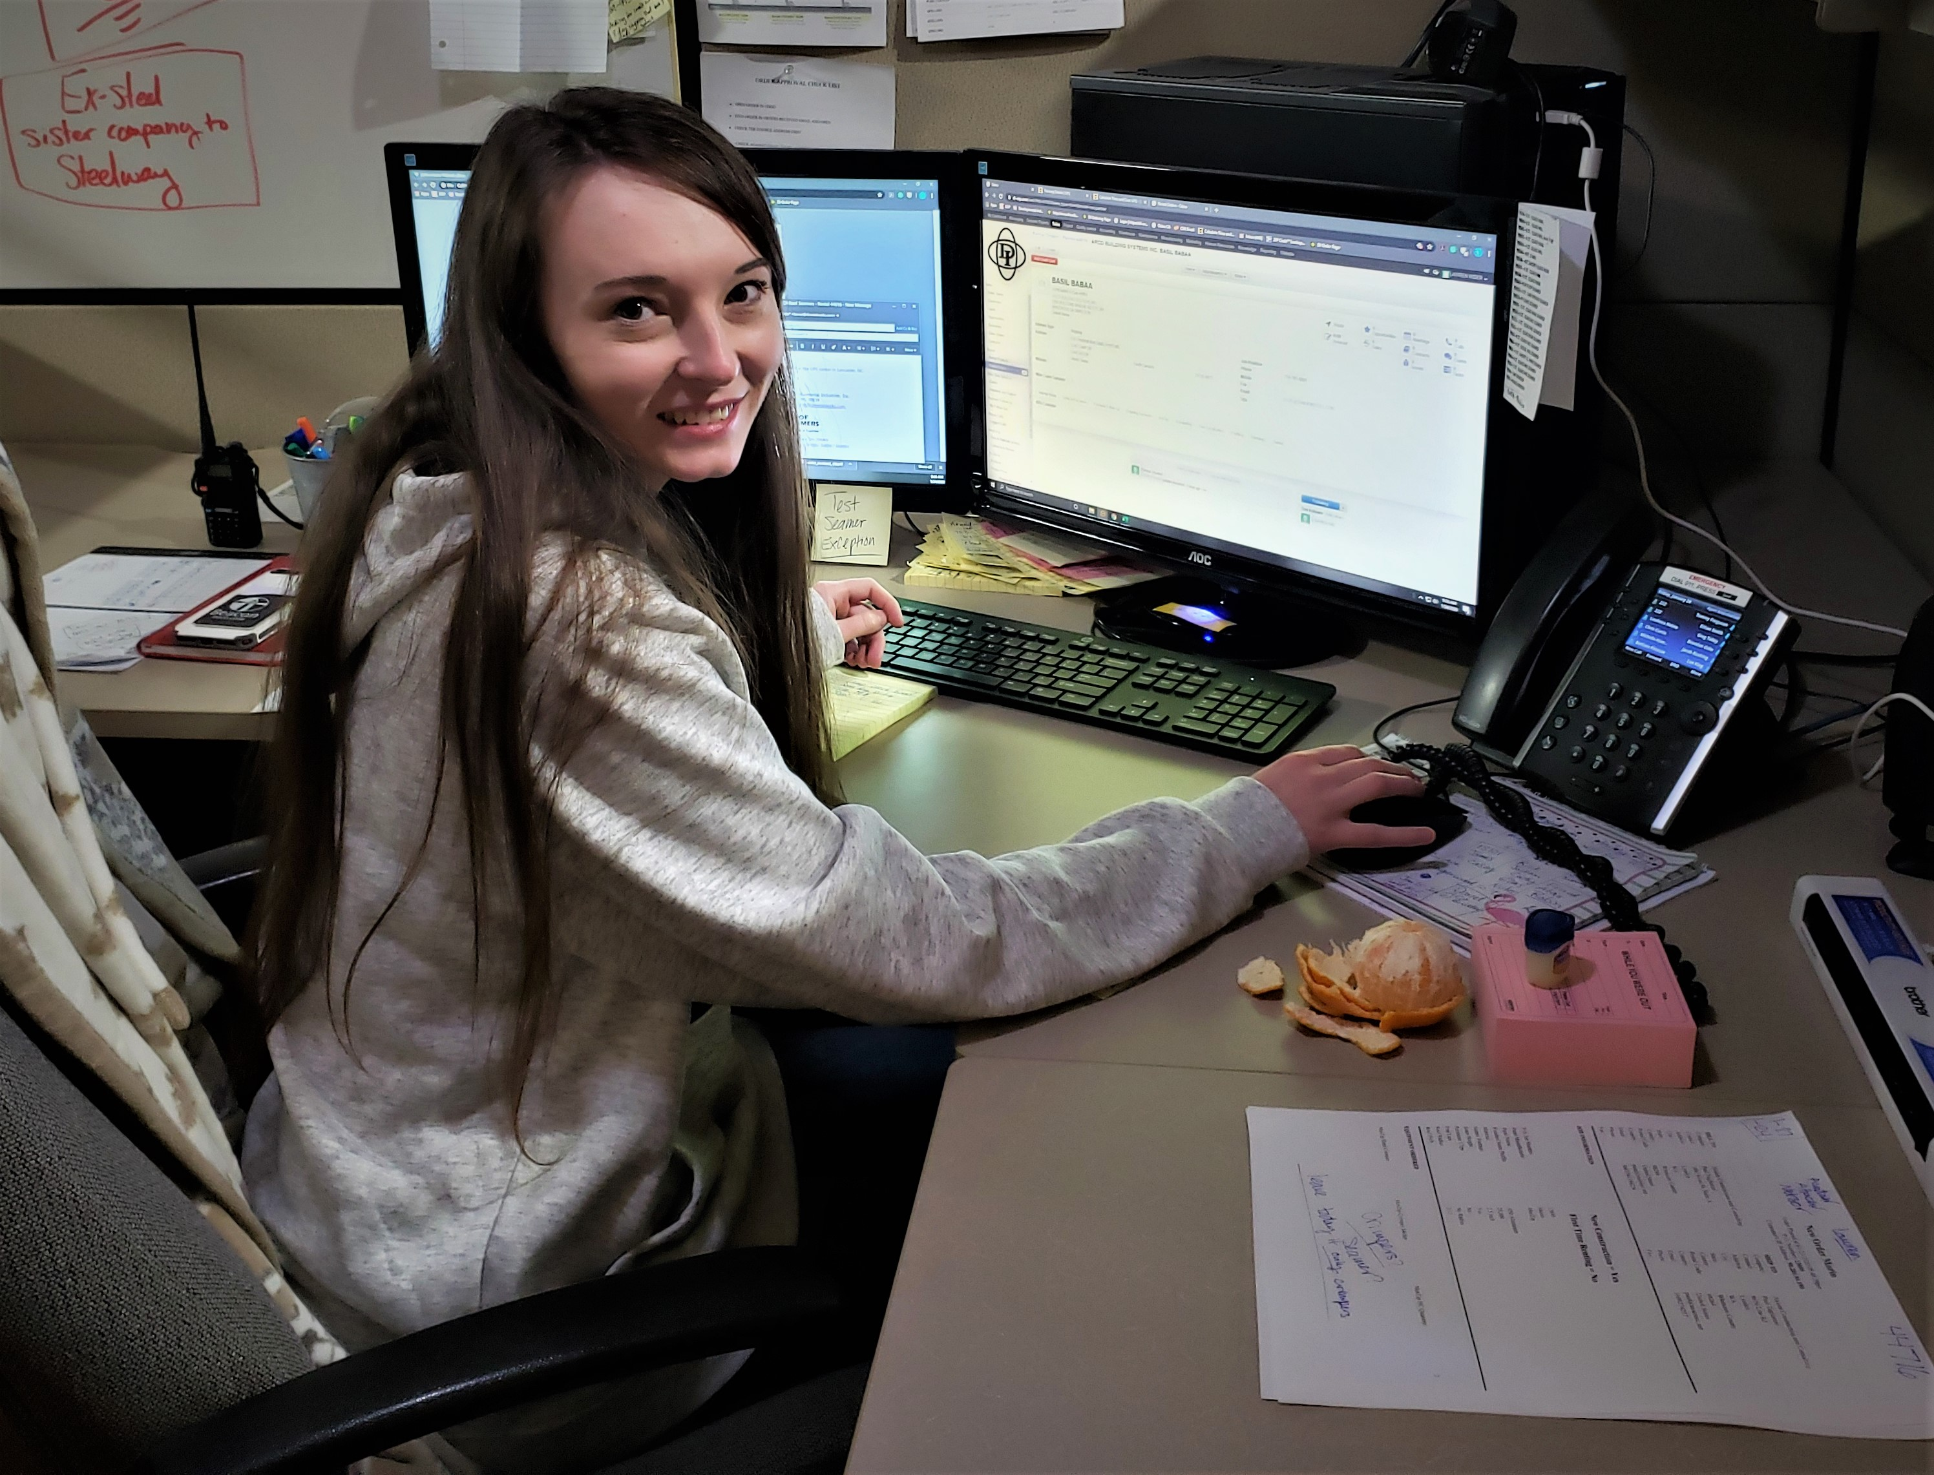
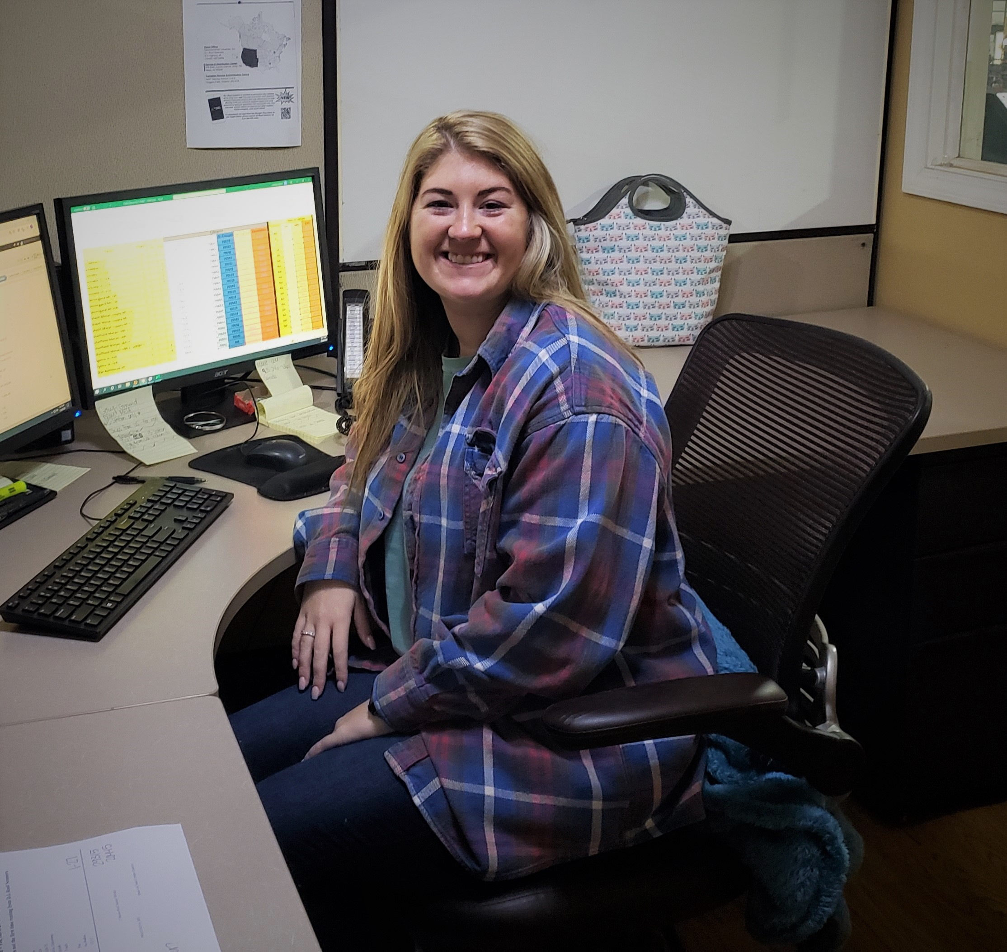
CSR Receives & Processes Order robertson.diroofseamers.com/
CSR receives and reviews your “submitted” order.
CSR looks for discrepancies, any entry other than standard for the specific panel to be seamed.
If discrepancies are found, customer is called.
Addresses are verified for correctness and credit card is “pre-authorized” for $1000.00.
Order is sent to Manager for “Approval” where it is checked once again for correctness.
Order is electronically sent to the floor for same or next day processing or “queued” for processing per the requested arrival date.

Slide 6
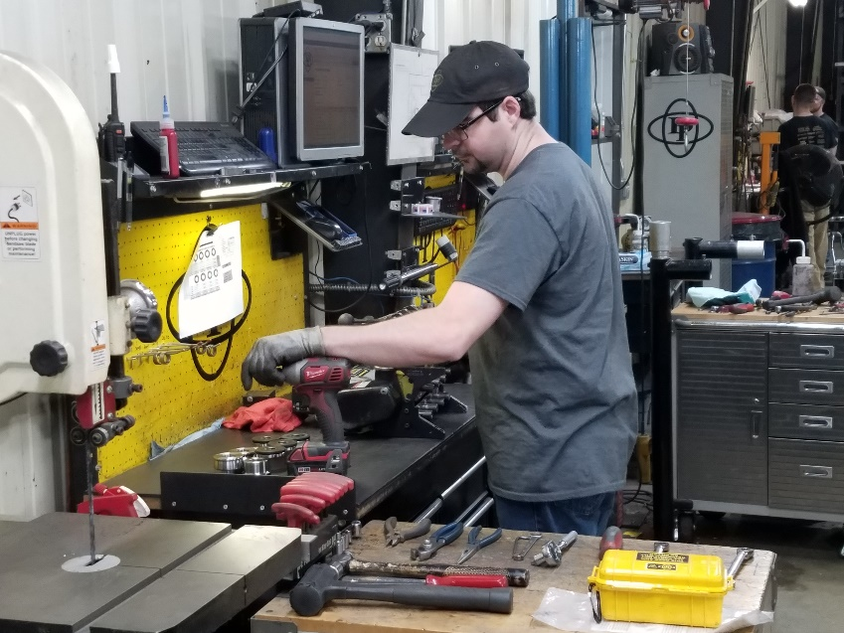
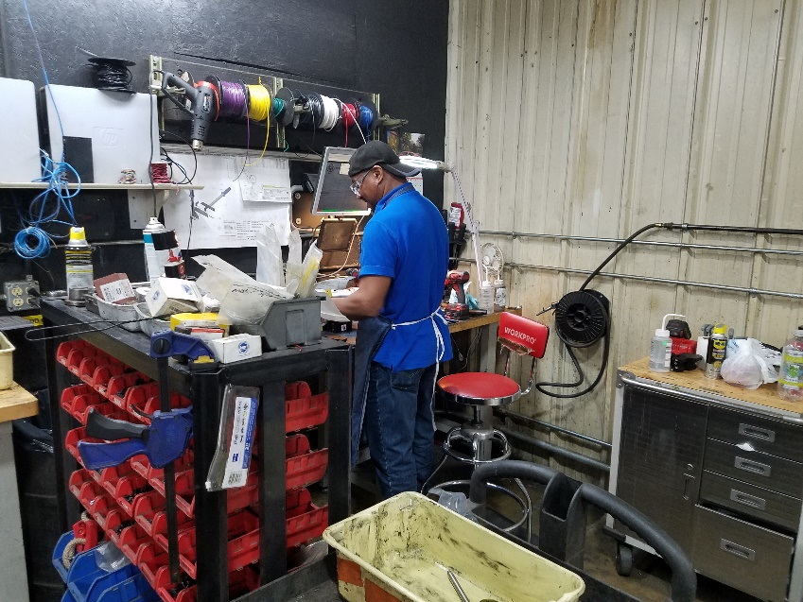
ASSOCIATE II ASSEMBLY TO ORDER SPECIFICATIONS
When an order is processed, the appropriate chassis is supplied to Associate II from inventory along with all tooling required to assemble the setup for the specific panel profile.
Associate II assembles the seamer utilizing documented tooling setup instructions.
These setup instructions are meticulously tested and certified to ensure the seamer will produce exceptional seams upon arrival on the job site per panel specifications from the manufacturer.

Slide 7
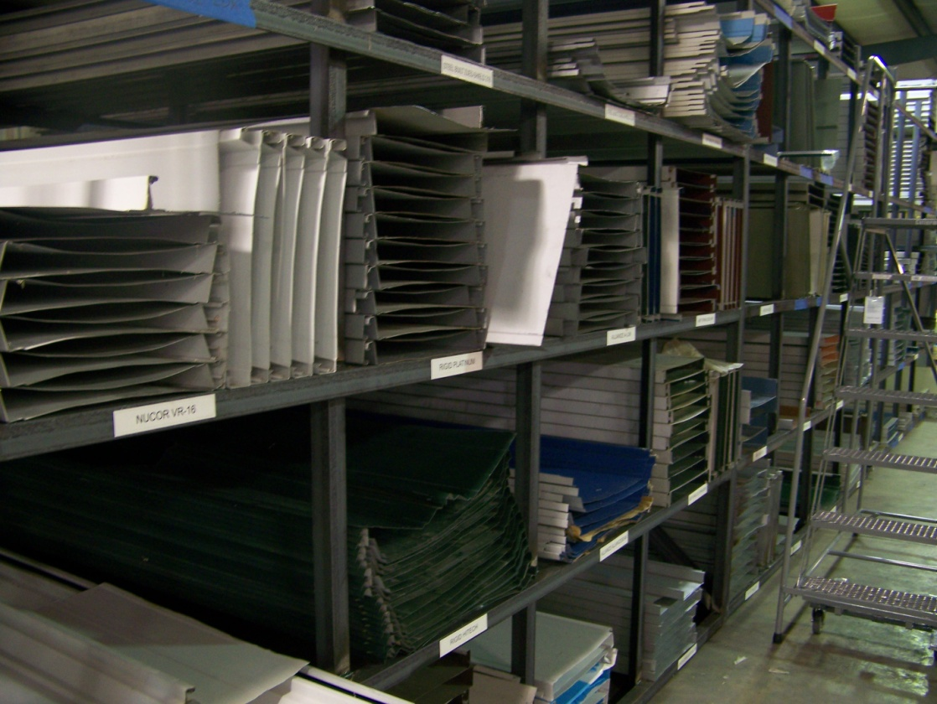
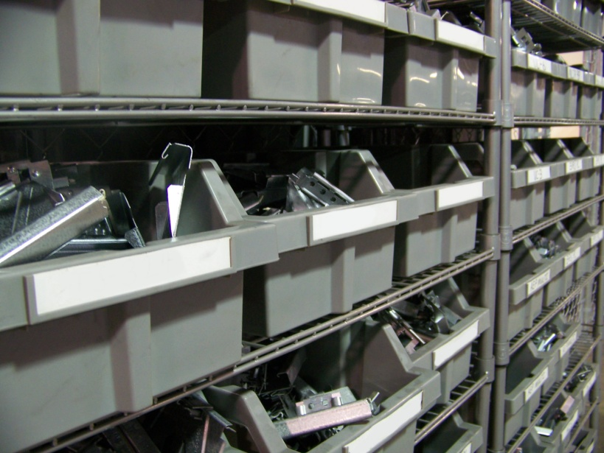
TESTING FINISHED SEAM TESTING AND FINAL CERTIFICATION
Some manufacturers supply test roof panels and clips to D.I. This ensures that the same quality panels are being used to test and certify rental seamers as those being installed on the job site.

Slide 8
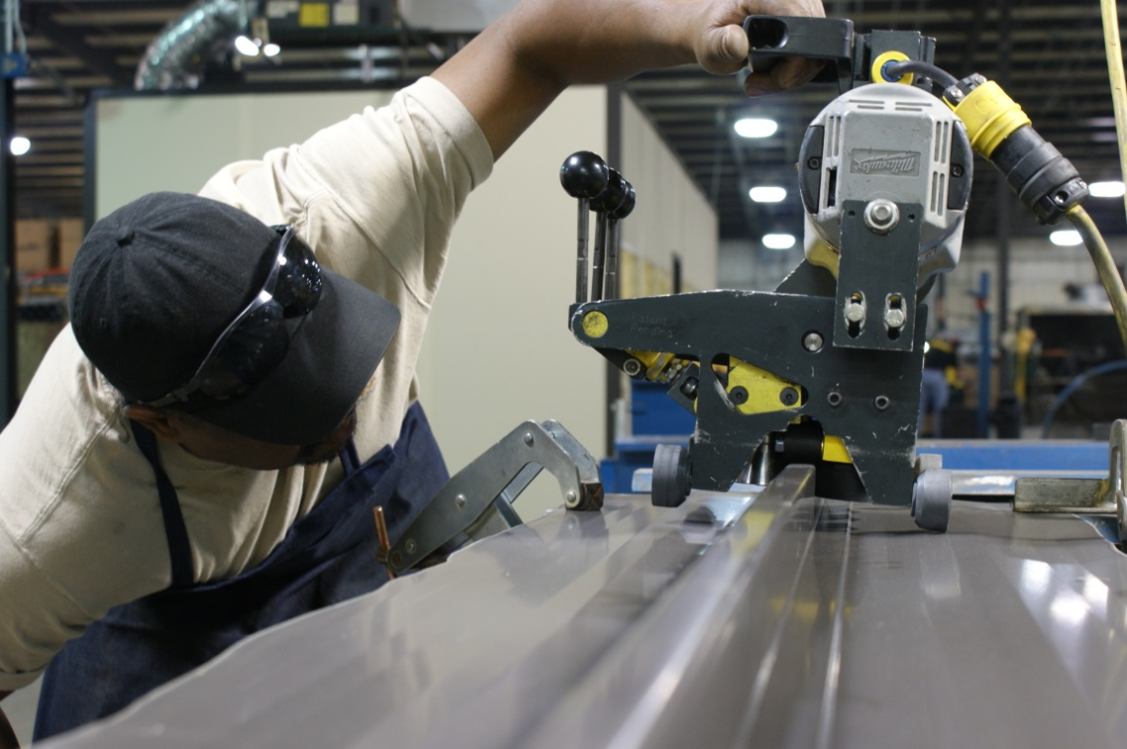
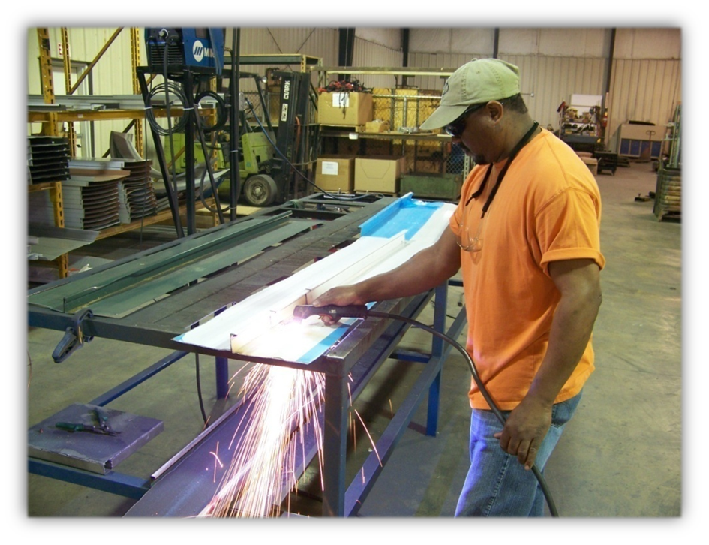
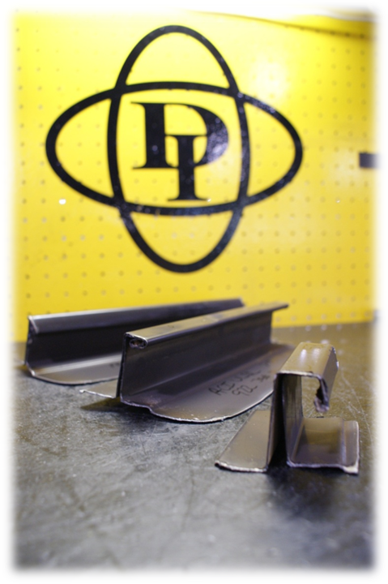
TESTING FINISHED SEAM TESTING AND FINAL CERTIFICATION
Many manufacturers agree to supply D.I. with test panels and clips. Rented machines can then be tested using the manufacturer supplied materials for the panel, just like the builder will be installing on the jobsite.
A test seam is completed, reviewed, and certified as conforming to specifications supplied to D.I. by the panel manufacturer.
After the test seam has been successfully completed and certified, a sample of the seam (including the clip) is cut away, cataloged, and held for the duration of the job.

Slide 9
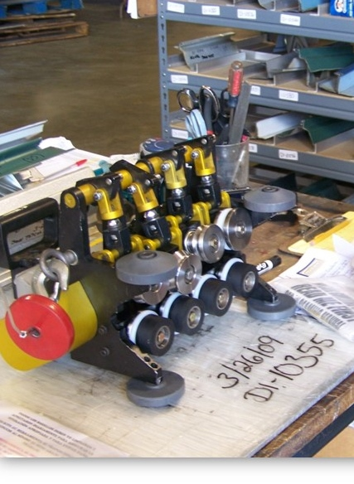
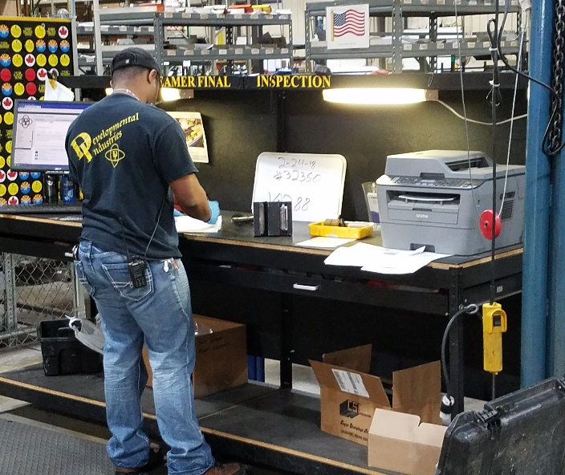
FINAL INSPECTION & SHIPPING
At Final Inspection, the seamer is inspected, once again, for any type of mechanical, cosmetic or other issues. Every component is rechecked for correctness.
The paperwork is reviewed again to insure everything is in order. If hand crimpers were ordered, they are checked as well.
A photograph is taken of the contents of the shipping case just prior to closing and sealing for shipping. The photo is filed and stored electronically.
Sealed case is sent to shipping.

Slide 10
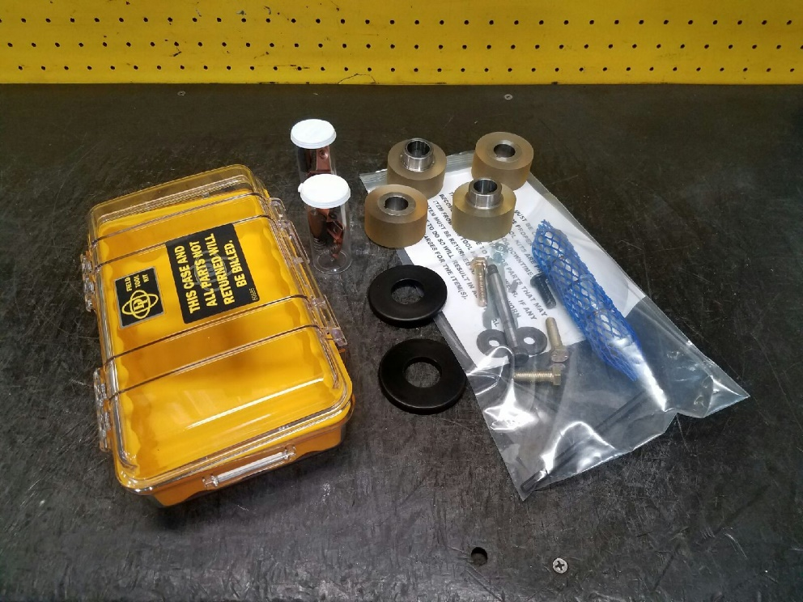
FINAL INSPECTION & SHIPPING
Each rented Seamer is shipped with a field repair tool kit to limit downtime in the field.

Slide 11
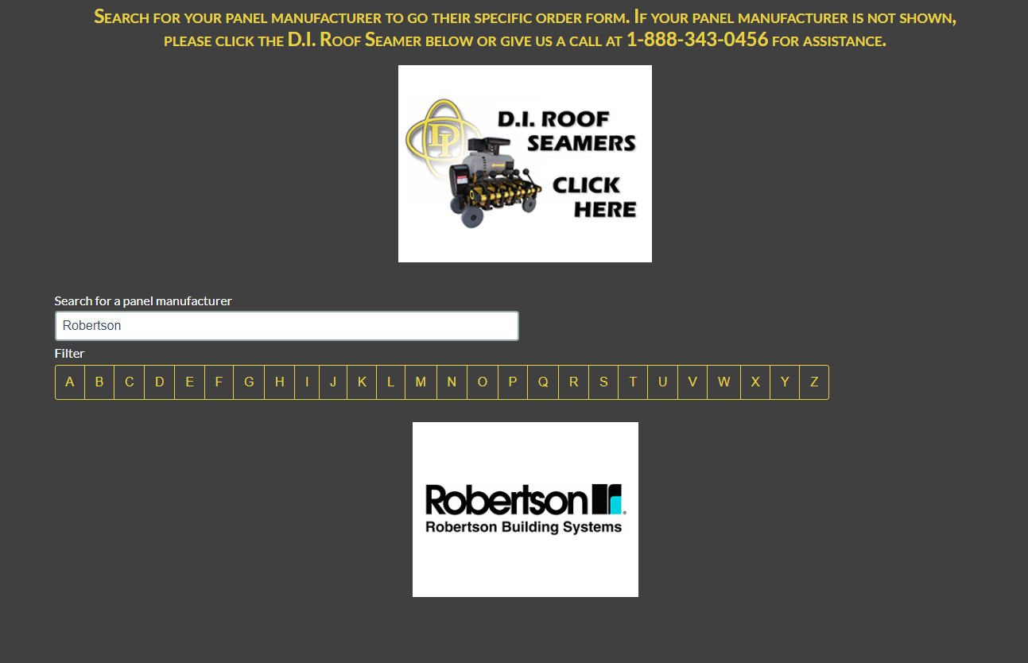
Filling out an order form
Go to diroofseamers.com
Search for Robertson

Slide 12
Filling out an order form

Slide 13
Address Information
Fill in everything with a RED asterisk, these are required fields

Slide 14
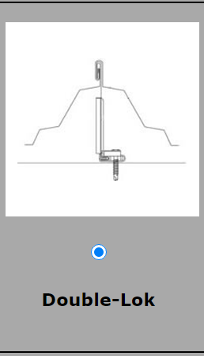
Select your Finished Seam Profile

Slide 15
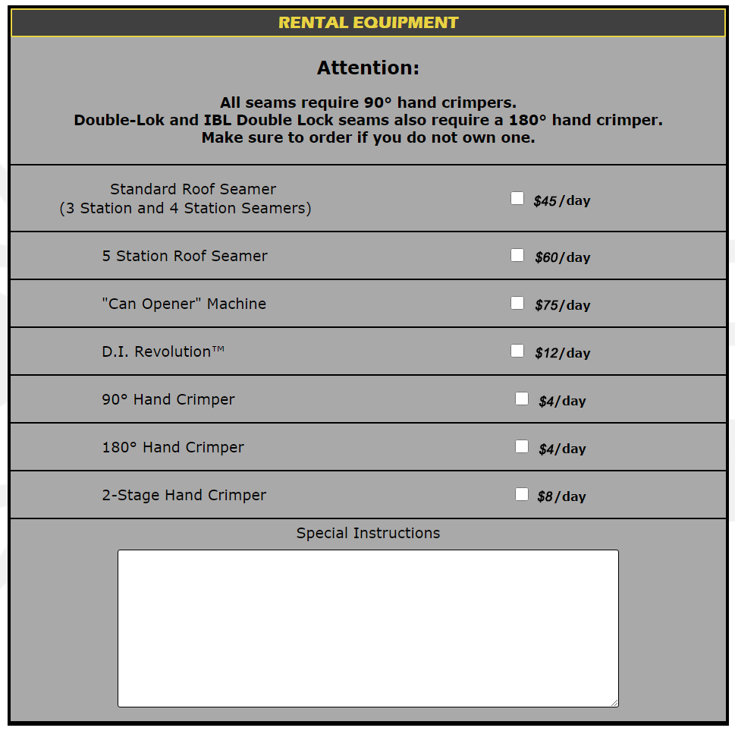
You can enter any questions, messages, or requests in this area.

Slide 16
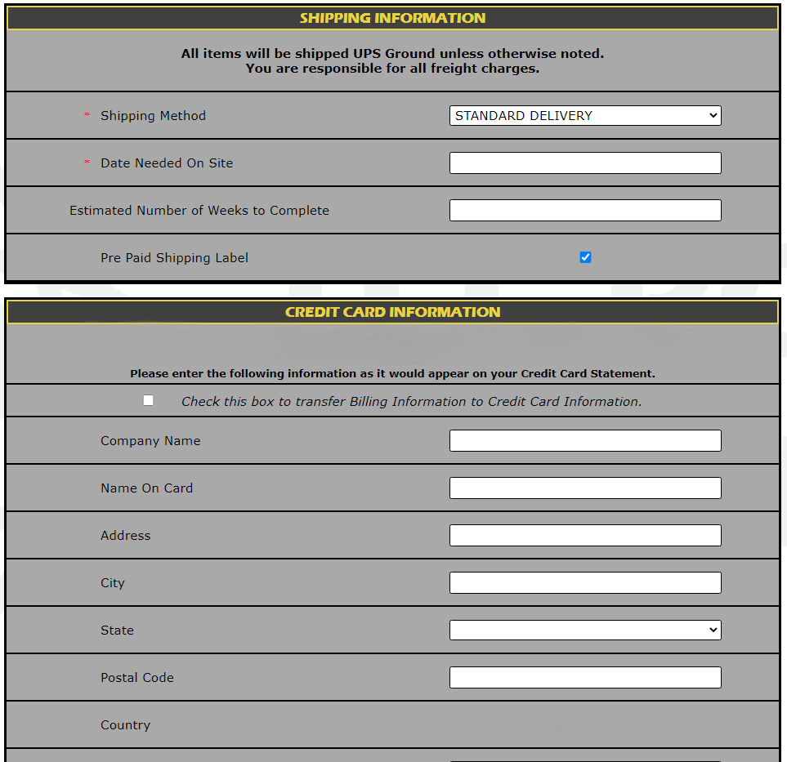
NO ORDER will ship without pre-auth.

Slide 17
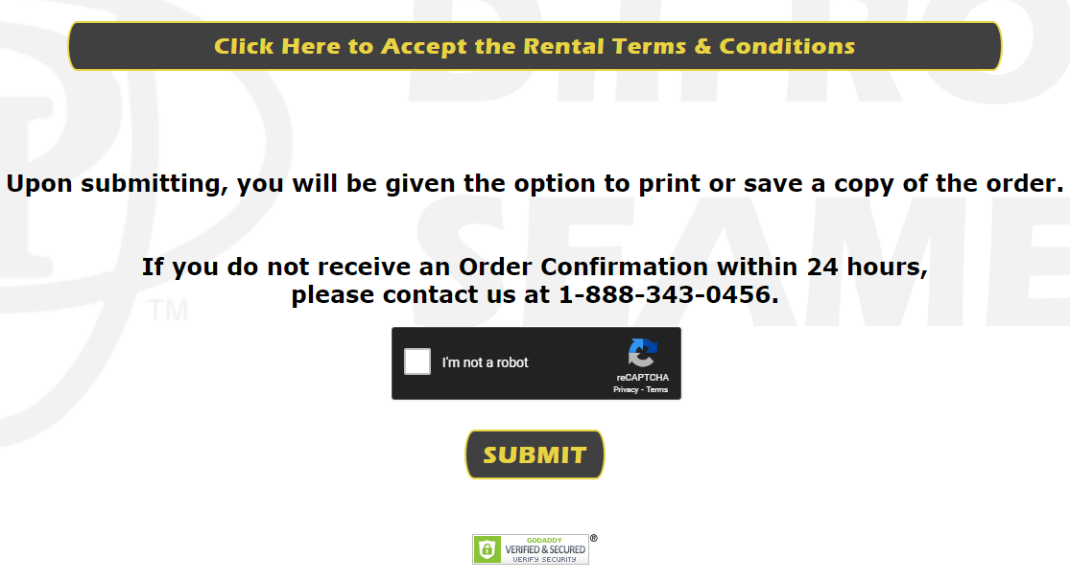
Terms and conditions and submitting order
Click here for the security prompt and be sure to get a green checkmark.

Slide 18
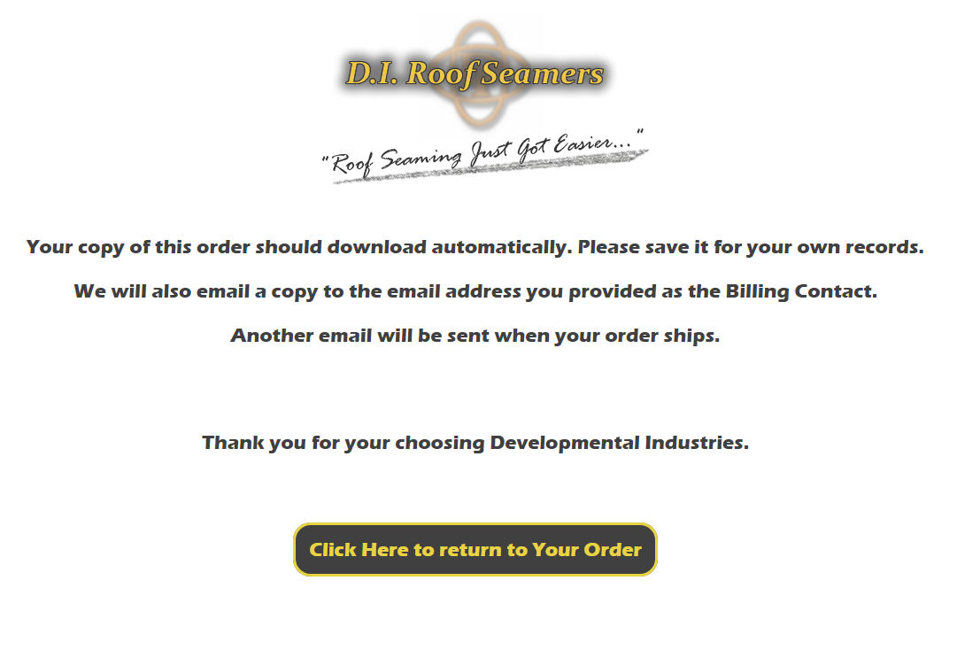
After you order
If you do not get to this page, your order information is not complete and did not submit. any missing information will be highlighted in red.

Slide 19
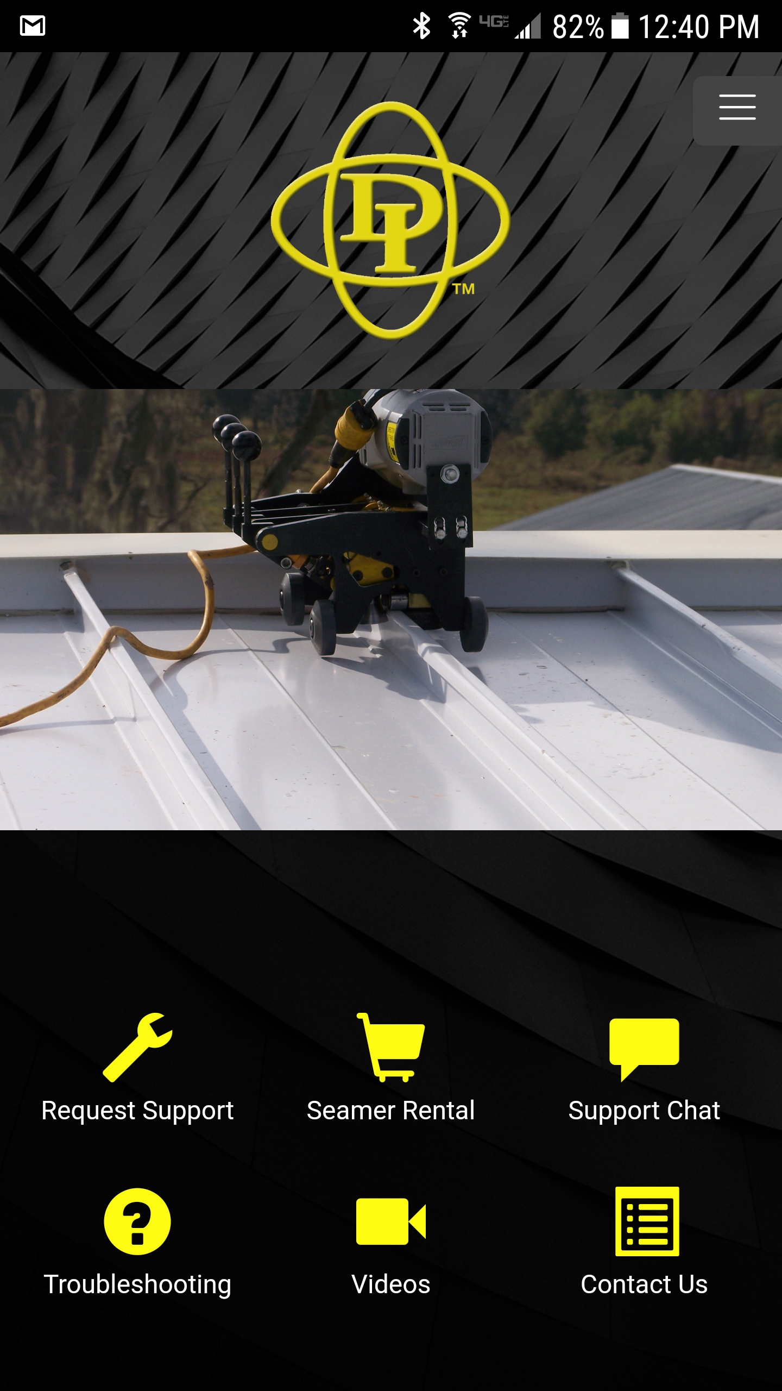
Mobile APp
“SEAMER RENTAL” Link
“REQUEST SUPPORT” Link
“SUPPORT CHAT” Link with D.I. Technician
“TROUBLE SHOOTING” Link (Common Questions)
“VIDEOS” Link (Bank of Helpful Videos)
“CONTACT US” Link
Available for Free Download to Any Apple or Android Device
Available in the App Store and on Google Play

Slide 20
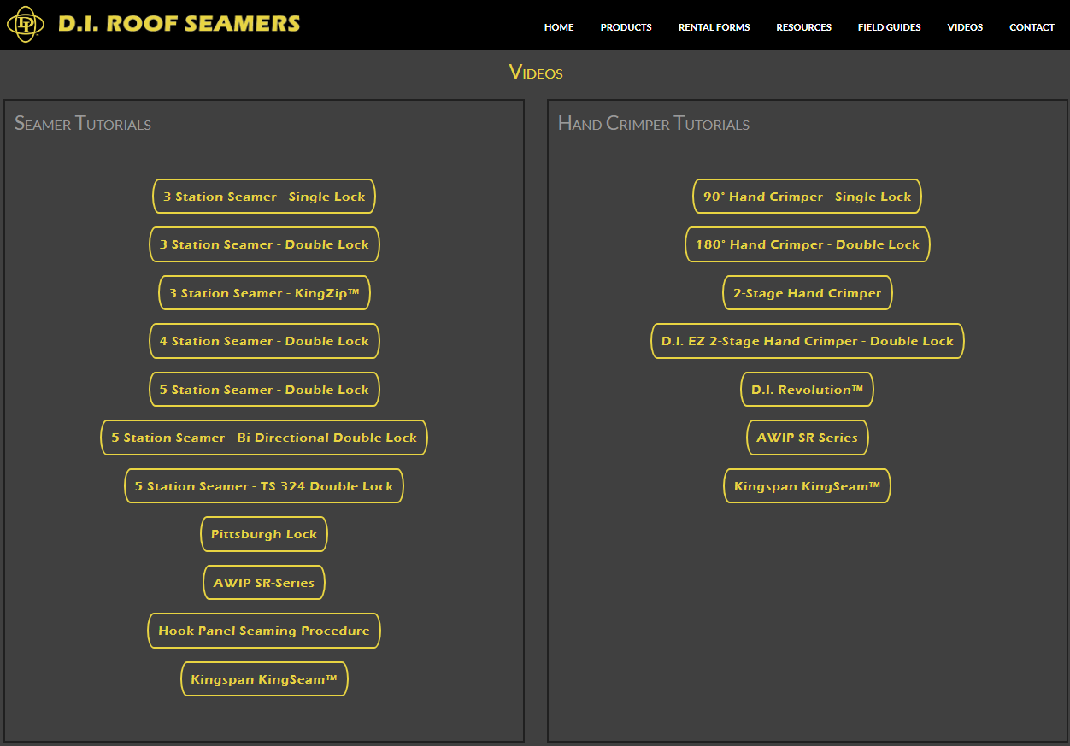
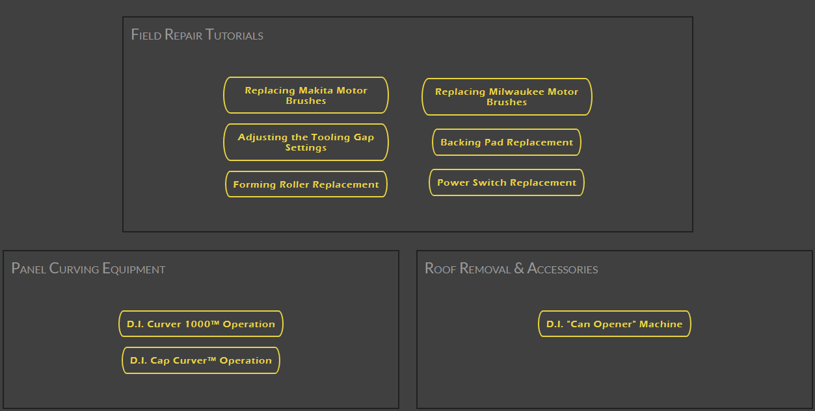
diroofseamers.com
Check out our video library!
More videos being added
Tutorials and Troubleshooting
Tech support available, too!
General tutorials as well as panel specific tutorials.

Slide 21
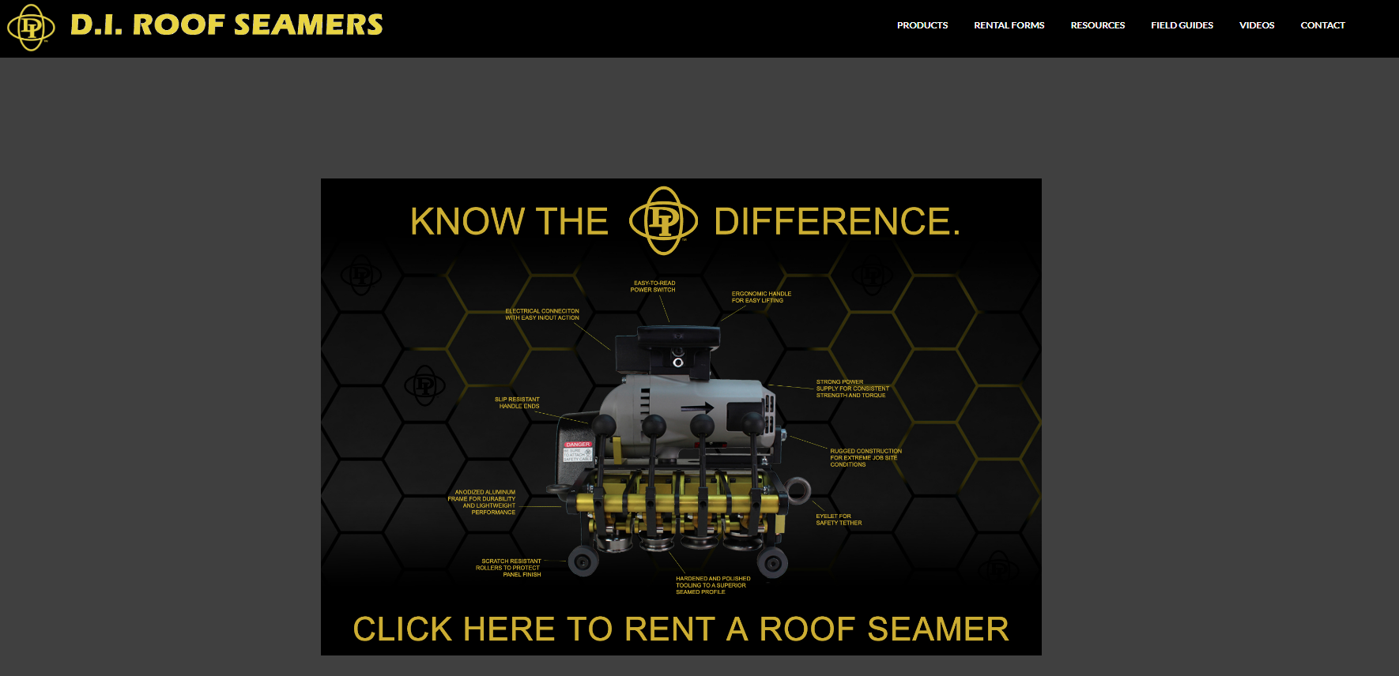
Purchasing
Go to diroofseamers.com

Slide 22
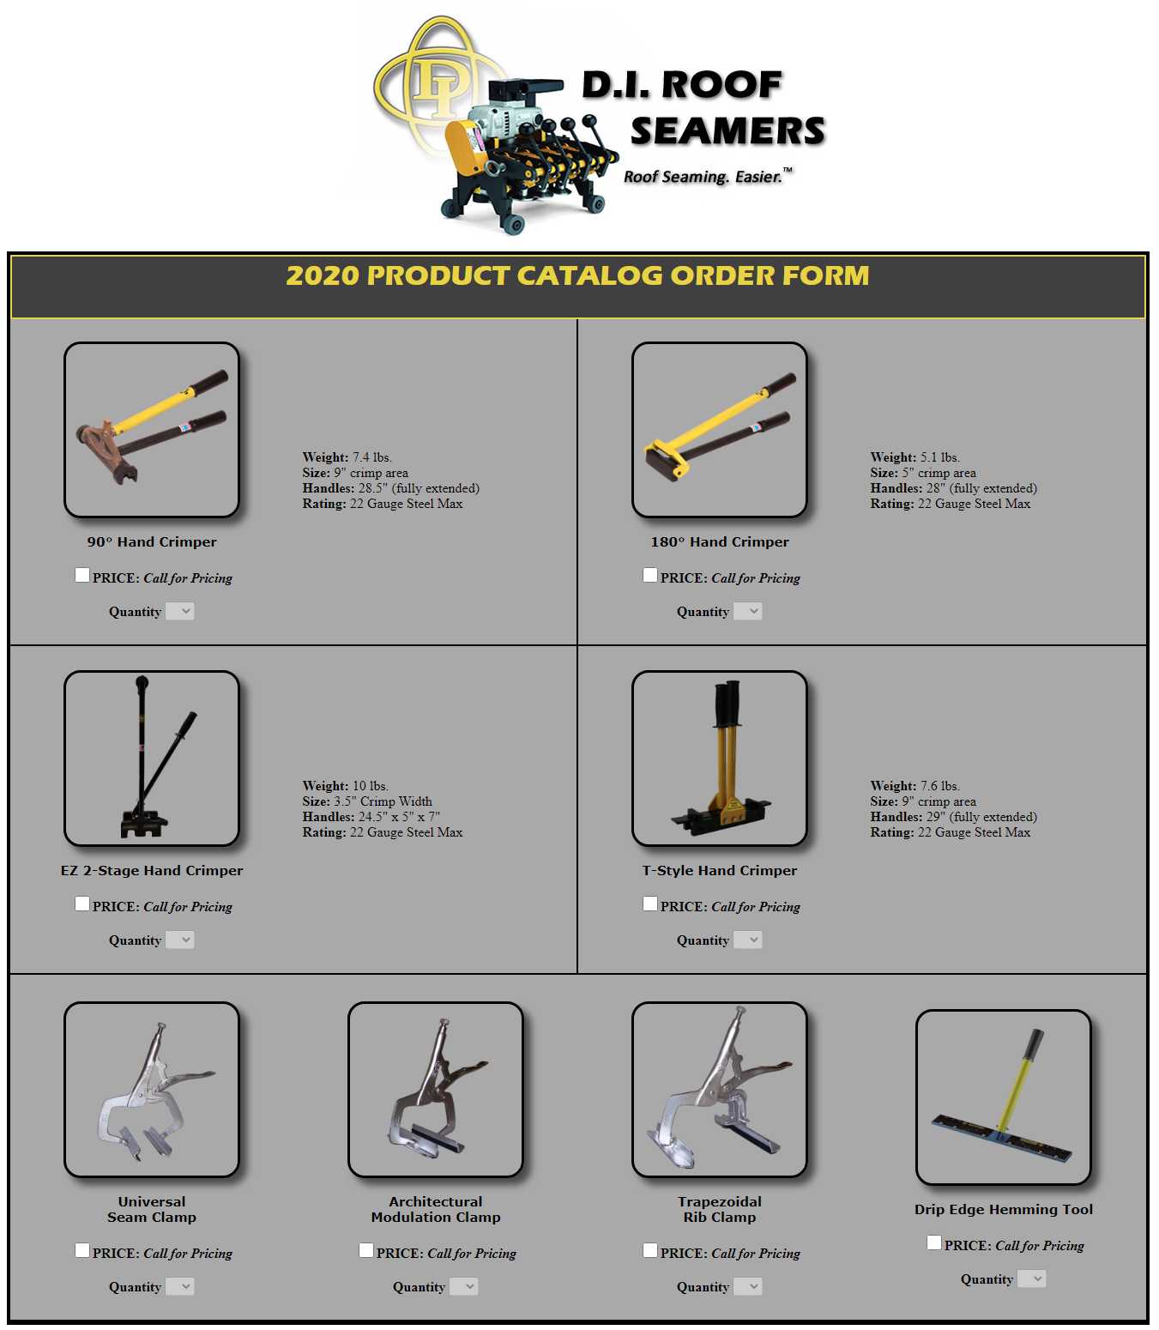
Products Catalog

Slide 23
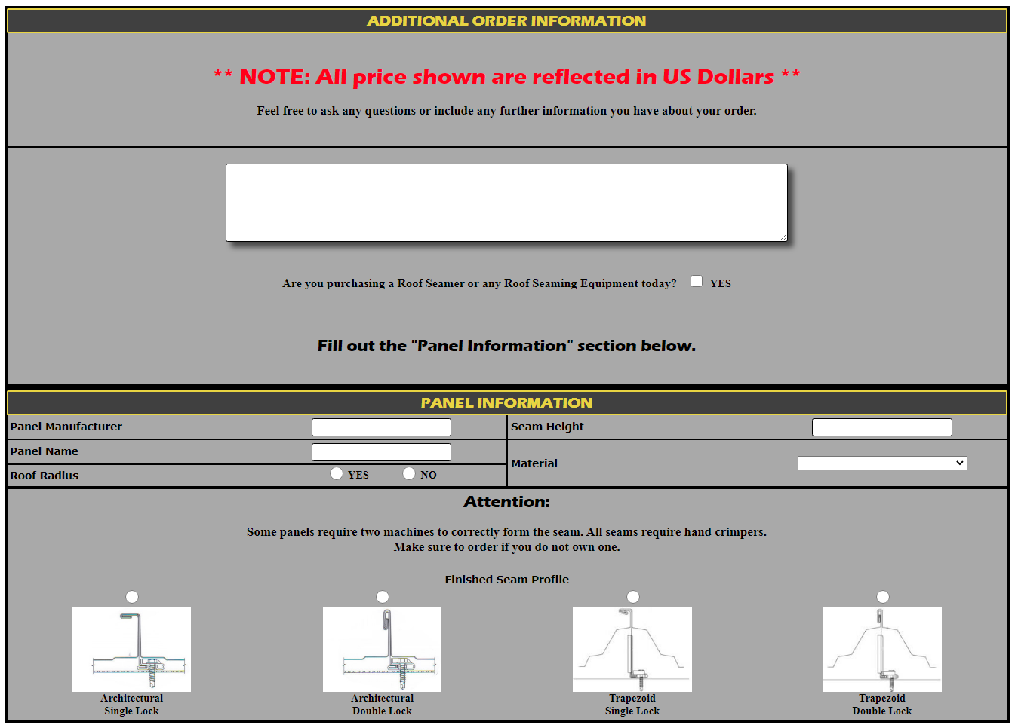
You can enter any questions, messages, or requests in this area.

Slide 24
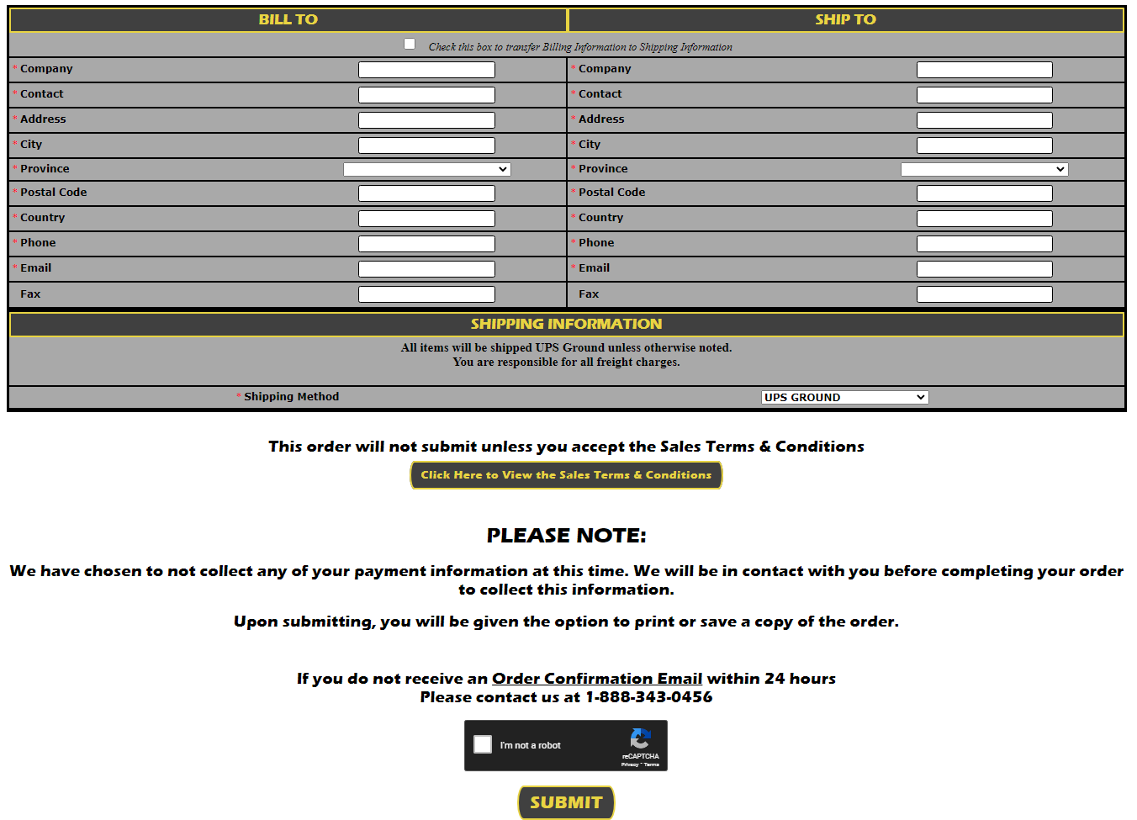

Slide 25
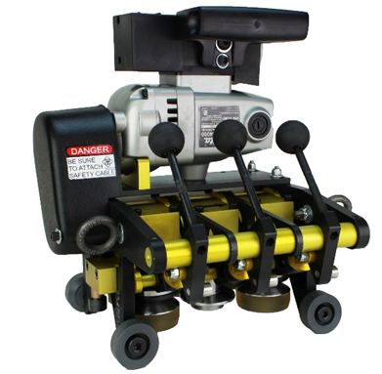
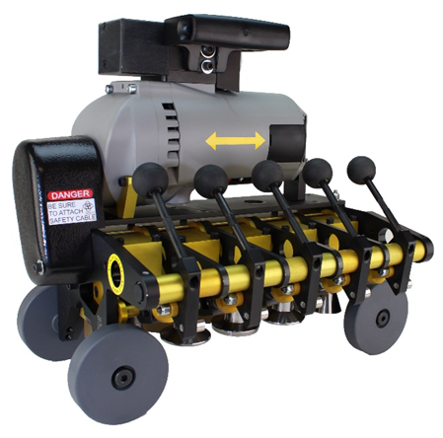
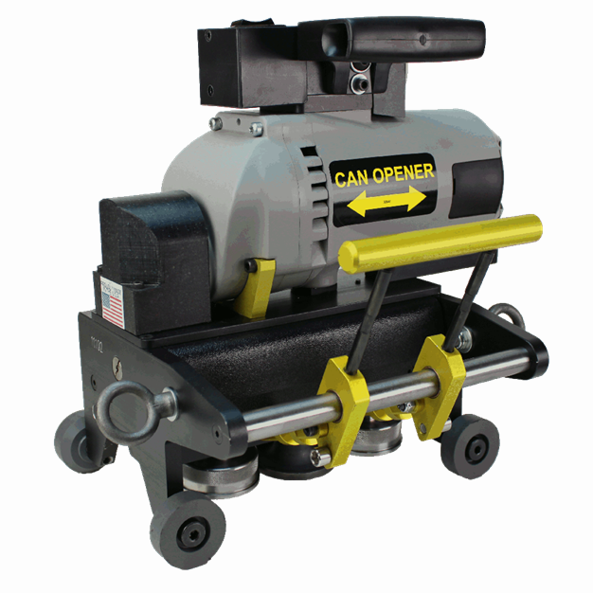
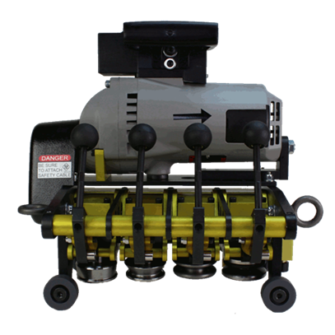
RENTAL SEAMERS FOR ROOF PANELS
3 Station
STANDARD SEAMER
$45/day (USD)
5 Station
BI-DIRECTIONAL SEAMER
$60/day (USD)
4 Station
STANDARD SEAMER
$45/day (USD)
CAN OPENER $75/day (USD)

Slide 26
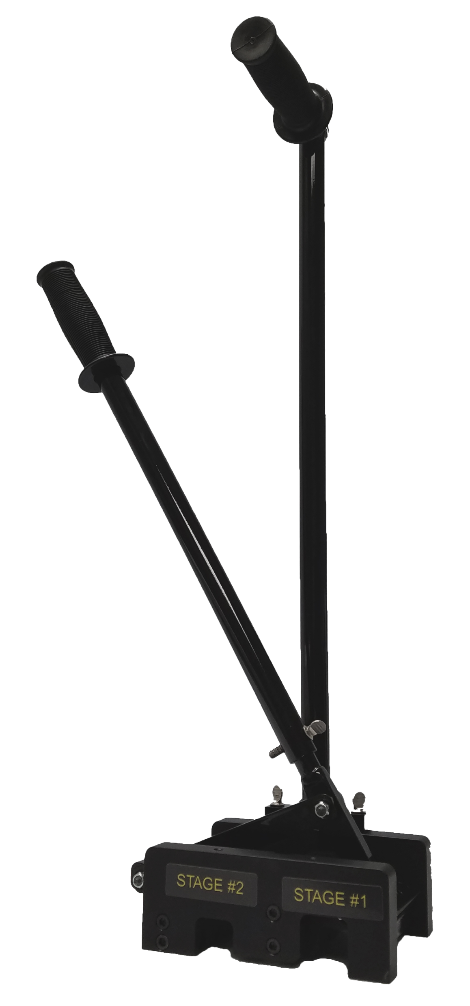
2-STAGE HAND CRIMPER
Two hand crimpers in one!
90° and 180° crimps without using separate tools.
Designed to offer ease of use on most double lock panel profiles.
Can be rented for ROBERTSON DOUBLE-LOK and SUPERLOK standing seam panel profiles @ $8.00/Day (USD).
Purchase Price $375.00 (USD).

Slide 27
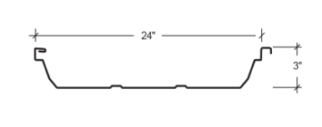
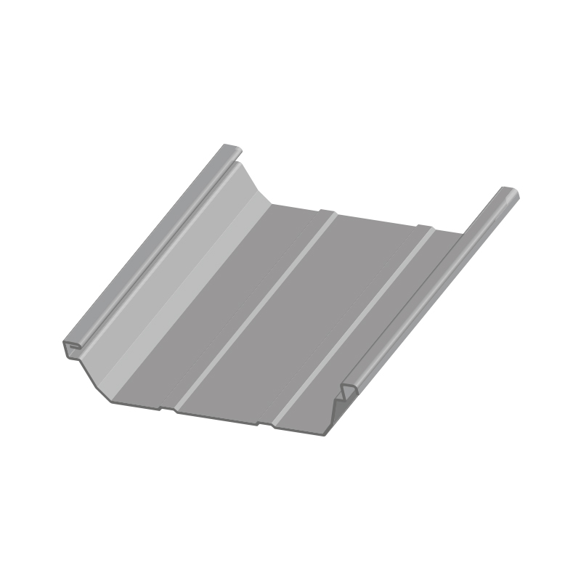
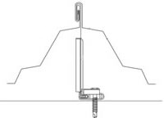
Robertson Building SYstems
Double-Lok
4 Station
Single Direction D/L
180 Degree
Roof Seamer
$45/day (USD)
5 Station
Bidirectional D/L
180 Degree
Roof Seamer
$60/day (USD)

Slide 28
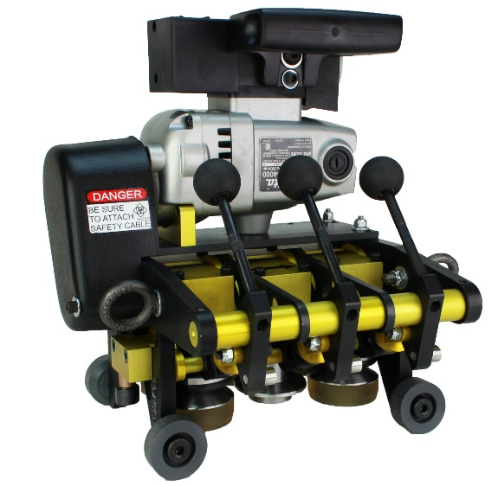
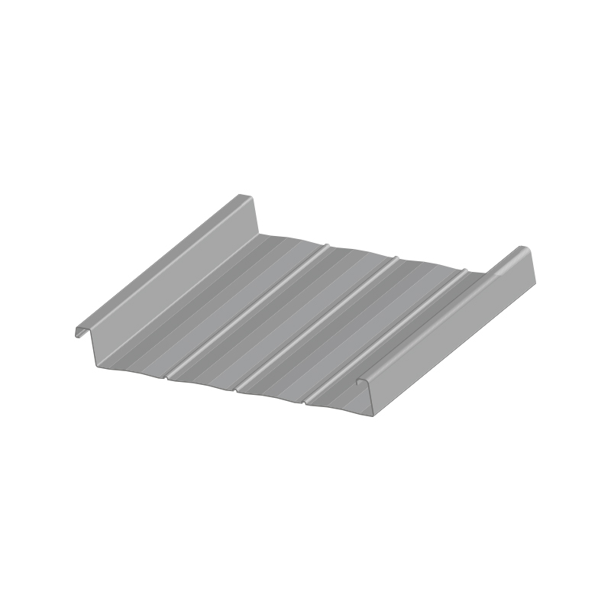
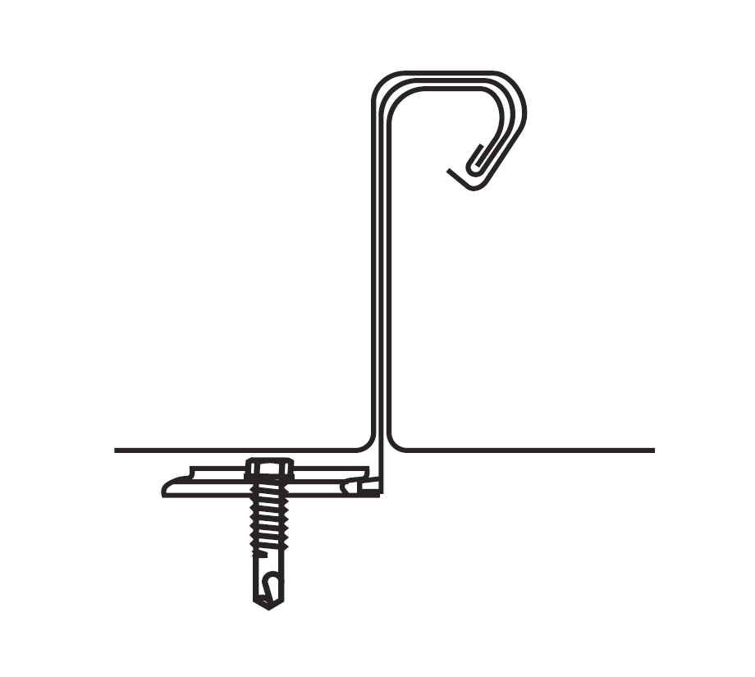
Robertson Building systems
BattenLOK HS
3 Station
Bidirectional S/L
90 Degree
Roof Seamer
$45/day (USD)

Slide 29
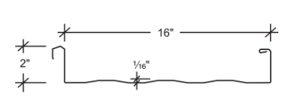
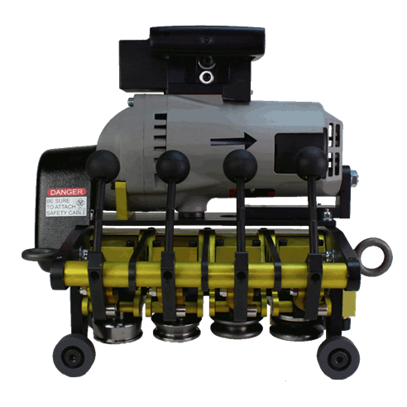
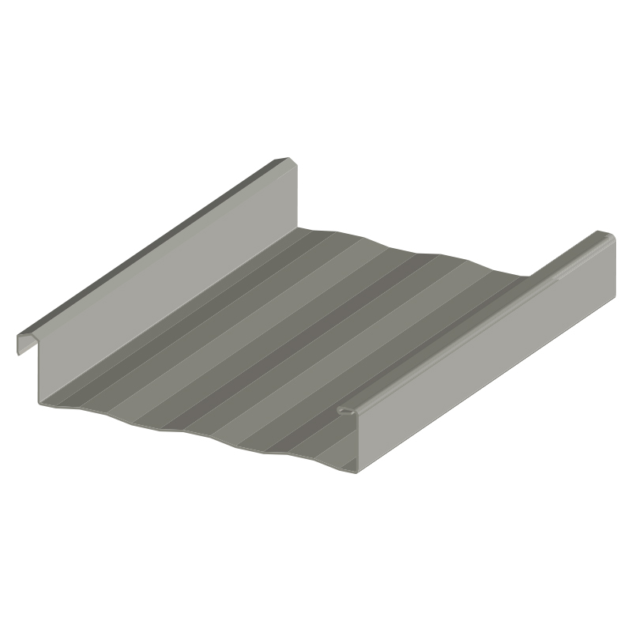
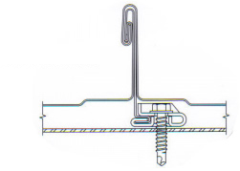
Robertson Building Systems
SuperLOK
4 Station
Single Direction D/L
180 Degree
Roof Seamer
$45/day (USD)

Slide 30
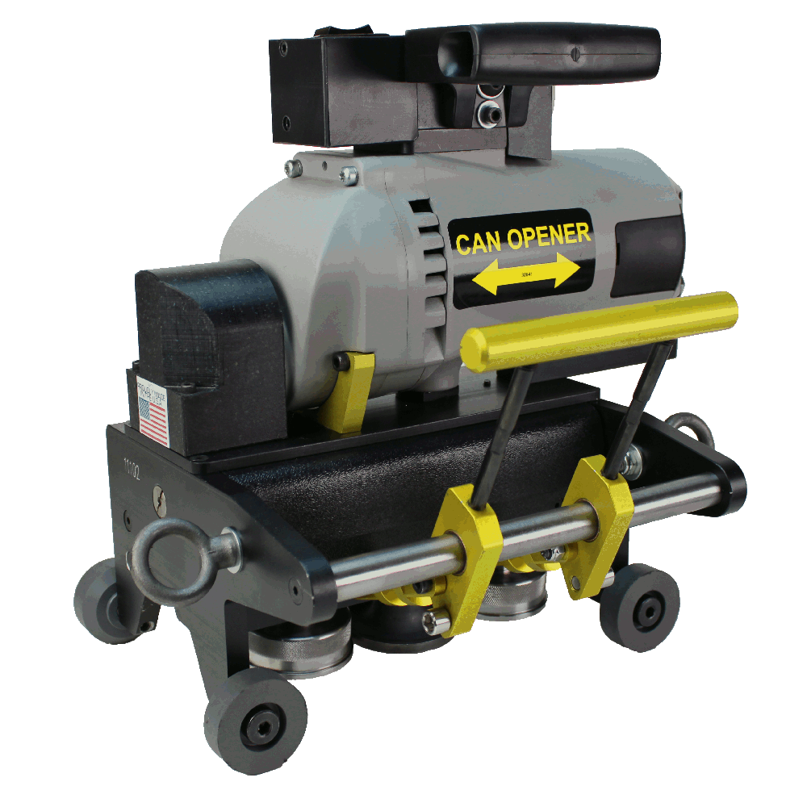
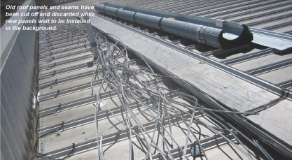
MACHINE
Can Opener Machine
$75/day (USD)
Speed: ≈38 ft/min
Weight: 44 lbs.

Slide 31
TECHNICAL SUPPORT
We have a staff of Technical Service Representatives ready to answer questions, troubleshoot issues, and help you make sure you are running on time, every time.
Access to 7 days per week technical support from the job site
PHONE: 1-888-343-0456
MOBILE APP: Chat feature for 7 days per week access.
Available for Apple and Android
SERVICE CENTER: Corinth, MS and Mesa, AZ

Slide 32
Headquarters/
Eastern Service Center
915 Highway 45
Corinth, MS 38834
Western Service Center
419 East Juanita Avenue
Mesa, AZ 85204
1-888-343-0456 | www.diroofseamers.com

Slide 33
Questions?

